Slide 1
Chapter 9 Classes: A Deeper Look; Throwing Exceptions
C++ How to Program, 9/e

Slide 4
9.1 Introduction
This chapter takes a deeper look at classes.
Coverage includes:
The example also demonstrates using an include guard in headers to prevent header code from being included in the same source code file more than once.
We demonstrate how client code can access a class’s public members via the name of an object, a reference to an object or a pointer to an object.
We discuss access functions that can read or write an object’s data members.
We also demonstrate utility functions—private member functions that support the operation of the class’s public member functions.

Slide 5
9.1 Introduction (cont.)
Coverage includes (cont.):
How default arguments can be used in constructors.
Destructors that perform “termination housekeeping” on objects before they’re destroyed.
The order in which constructors and destructors are called.
We show that returning a reference or pointer to private data breaks the encapsulation of a class, allowing client code to directly access an object’s data.
We use default memberwise assignment to assign an object of a class to another object of the same class.

Slide 6
9.1 Introduction (cont.)
Coverage includes (cont.):
const objects and const member functions to prevent modifications of objects and to enforce the principle of least privilege.
Composition—a form of reuse in which a class can have objects of other classes as members.
Friendship to specify that a nonmember function can also access a class’s non-public members—a technique that’s often used in operator overloading for performance reasons.
this pointer, which is an implicit argument in all calls to a class’s non-static member functions, allowing them to access the correct object’s data members and non-static member functions.

Slide 7
9.2 Time Class Case Study
Our first example (Fig. 9.1) creates class Time and tests the class.

Slide 11
9.2 Time Class Case Study (cont.)
In Fig. 9.1, the class definition is enclosed in the following include guard:
// prevent multiple inclusions of header file #ifndef TIME_H #define TIME_H ... #endif
Prevents the code between #ifndef and #endif from being included if the name TIME_H has been defined.
If the header has not been included previously in a file, the name TIME_H is defined by the #define directive and the header file statements are included.
If the header has been included previously, TIME_H is defined already and the header file is not included again.

Slide 14
9.2 Time Class Case Study (cont.)
Time Class Member Functions
In Fig. 9.2, the Time constructor (lines 11–14) initializes the data members to 0 - the universal-time equivalent of 12 AM.
Invalid values cannot be stored in the data members of a Time object, because the constructor is called when the Time object is created, and all subsequent attempts by a client to modify the data members are scrutinized by function setTime (discussed shortly).
You can define overloaded constructors for a class.

Slide 15
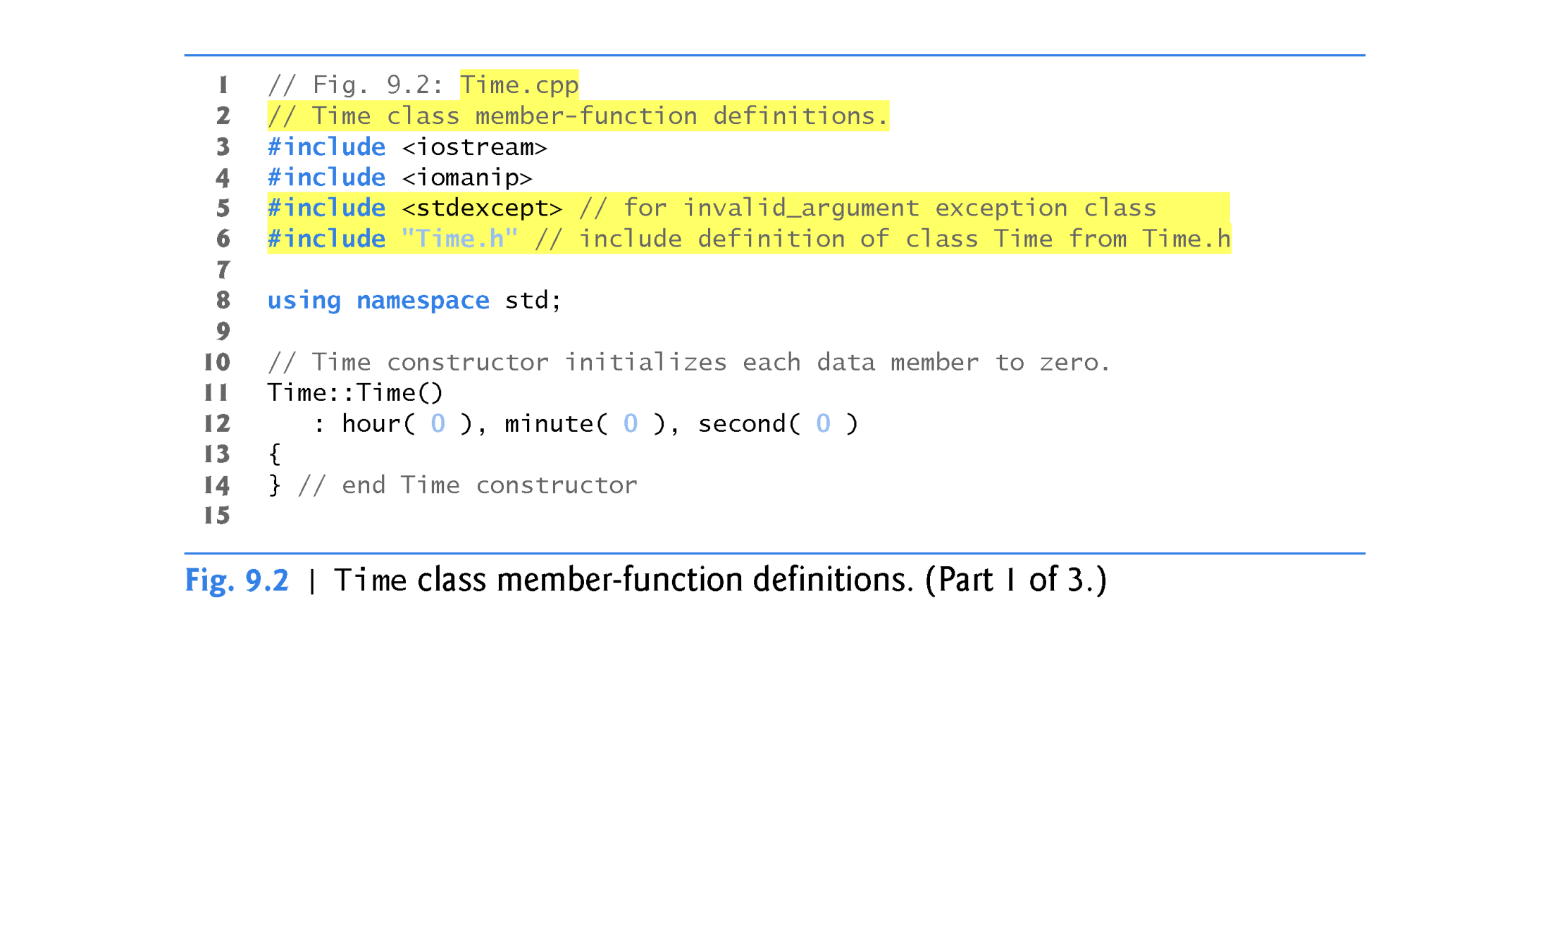

Slide 18
9.2 Time Class Case Study (cont.)
Before C++11, only static const int data members (which you saw in Chapter 7) could be initialized where they were declared in the class body.
For this reason, data members typically should be initialized by the class’s constructor as there is no default initialization for fundamental-type data members.
As of C++11, you can now use an in-class initializer to initialize any data member where it’s declared in the class definition.

Slide 19
9.2 Time Class Case Study (cont.)
Parameterized stream manipulator setfill specifies the fill character that is displayed when an integer is output in a field wider than the number of digits in the value.
The fill characters appear to the left of the digits in the number, because the number is right aligned by default - for left aligned values, the fill characters would appear to the right.
If the number being output fills the specified field, the fill character will not be displayed.
Once the fill character is specified with setfill, it applies for all subsequent values that are displayed in fields wider than the value being displayed.

Slide 21
9.2 Time Class Case Study (cont.)
Defining Member Functions Outside the Class Definition; Class Scope
Even though a member function declared in a class definition may be defined outside that class definition, that member function is still within that class’s scope.
If a member function is defined in the class’s body, the compiler attempts to inline calls to the member function.

Slide 27
9.2 Time Class Case Study (cont.)
Using Class Time
Once class Time has been defined, it can be used as a type in object, array, pointer and reference declarations as follows:
Time sunset; //object of type Time
array< Time, 5 > arrayOfTimes; //array of 5 Time objects
Time &timeRef = sunset; //reference to a Time object
timeRef.printUniversal(); //timeRef is an alias for sunset
Time *timePtr = &sunset; //pointer to a Time object
(*timePtr).printStandard(); //dereference using *
timePtr -> printStandard(); //dereference using arrow -> operator

Slide 28
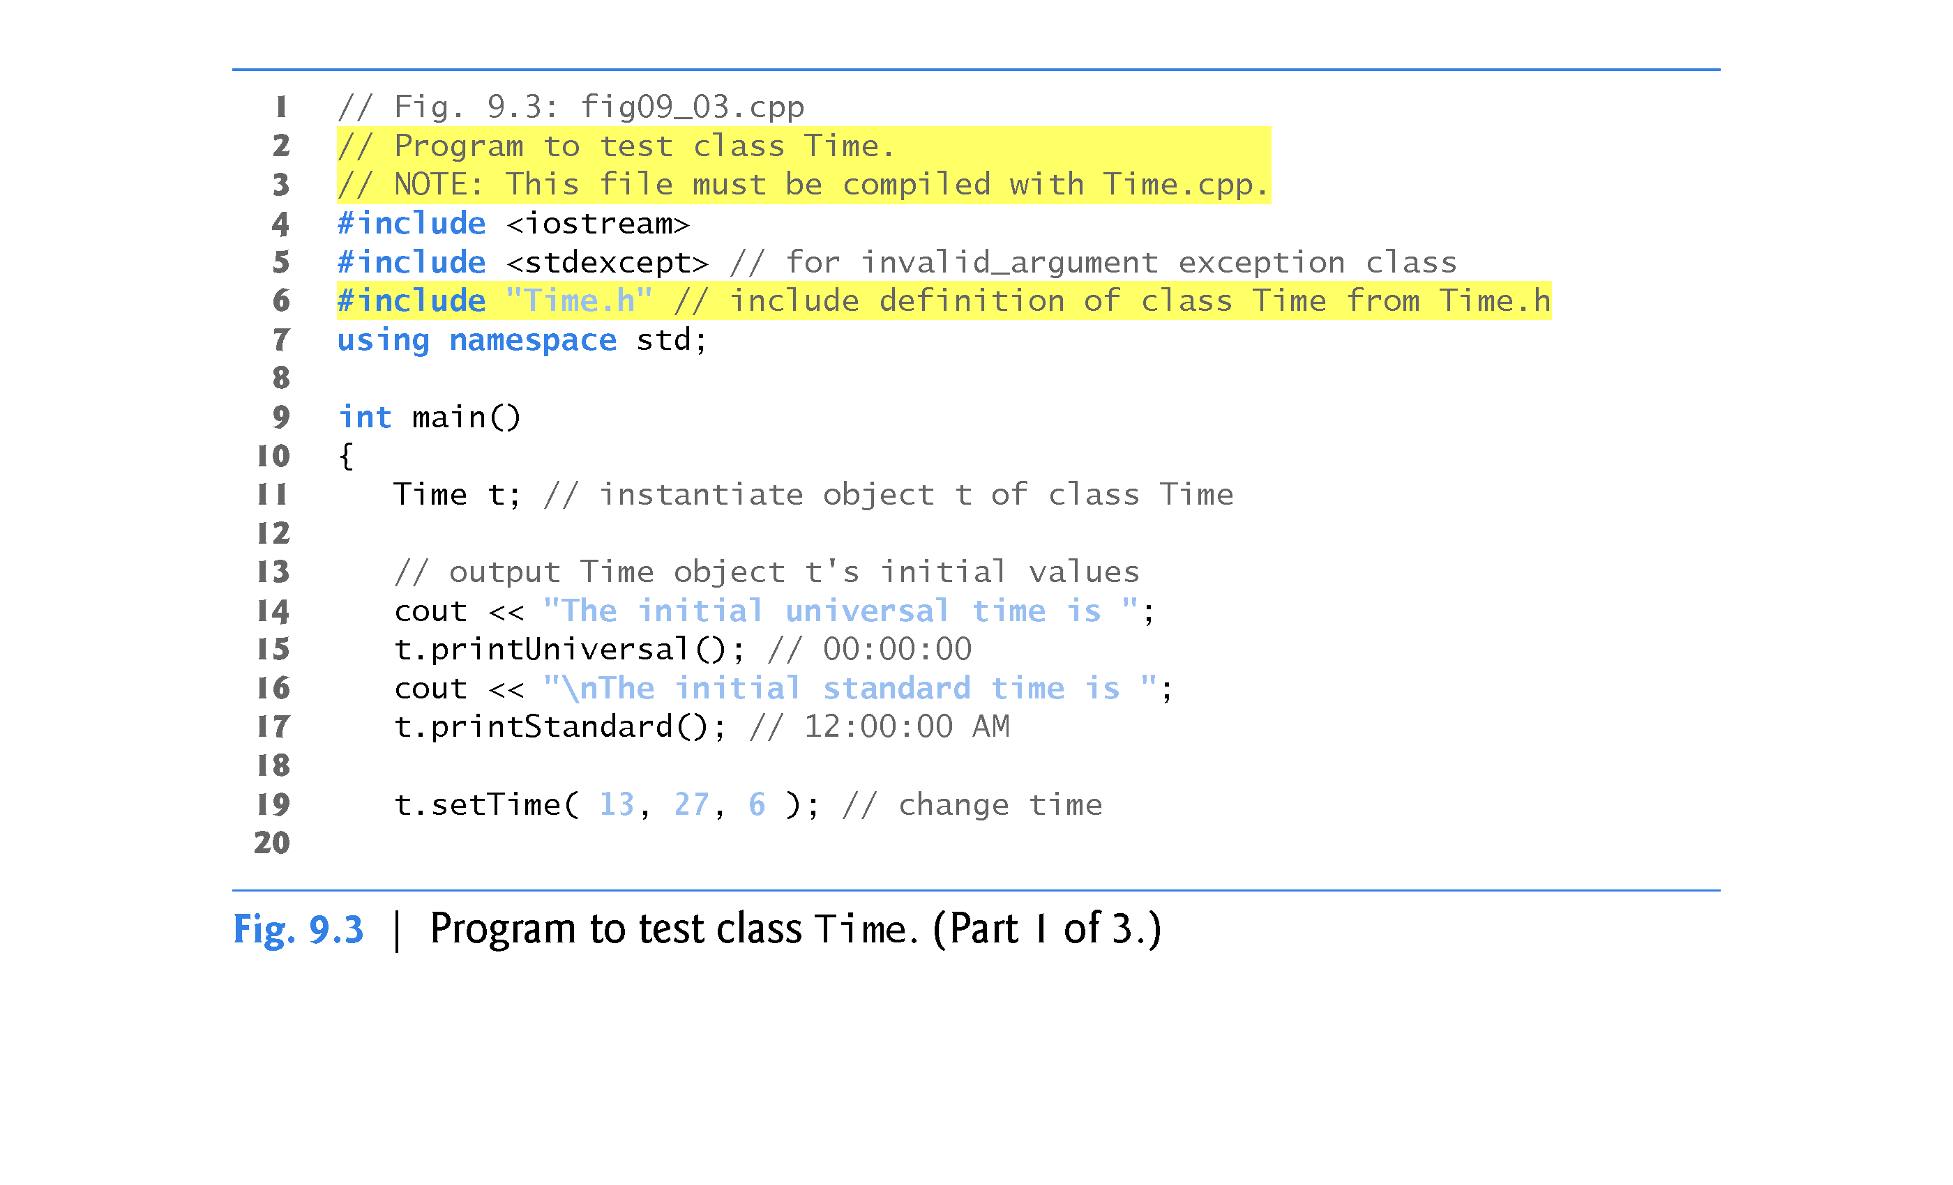

Slide 29
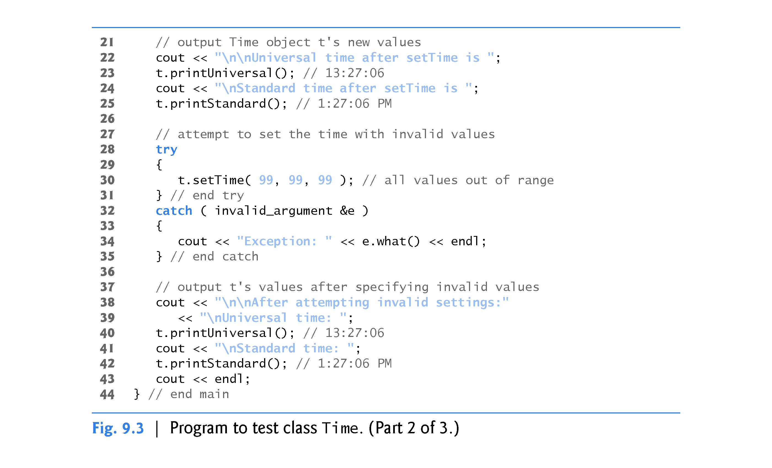

Slide 30
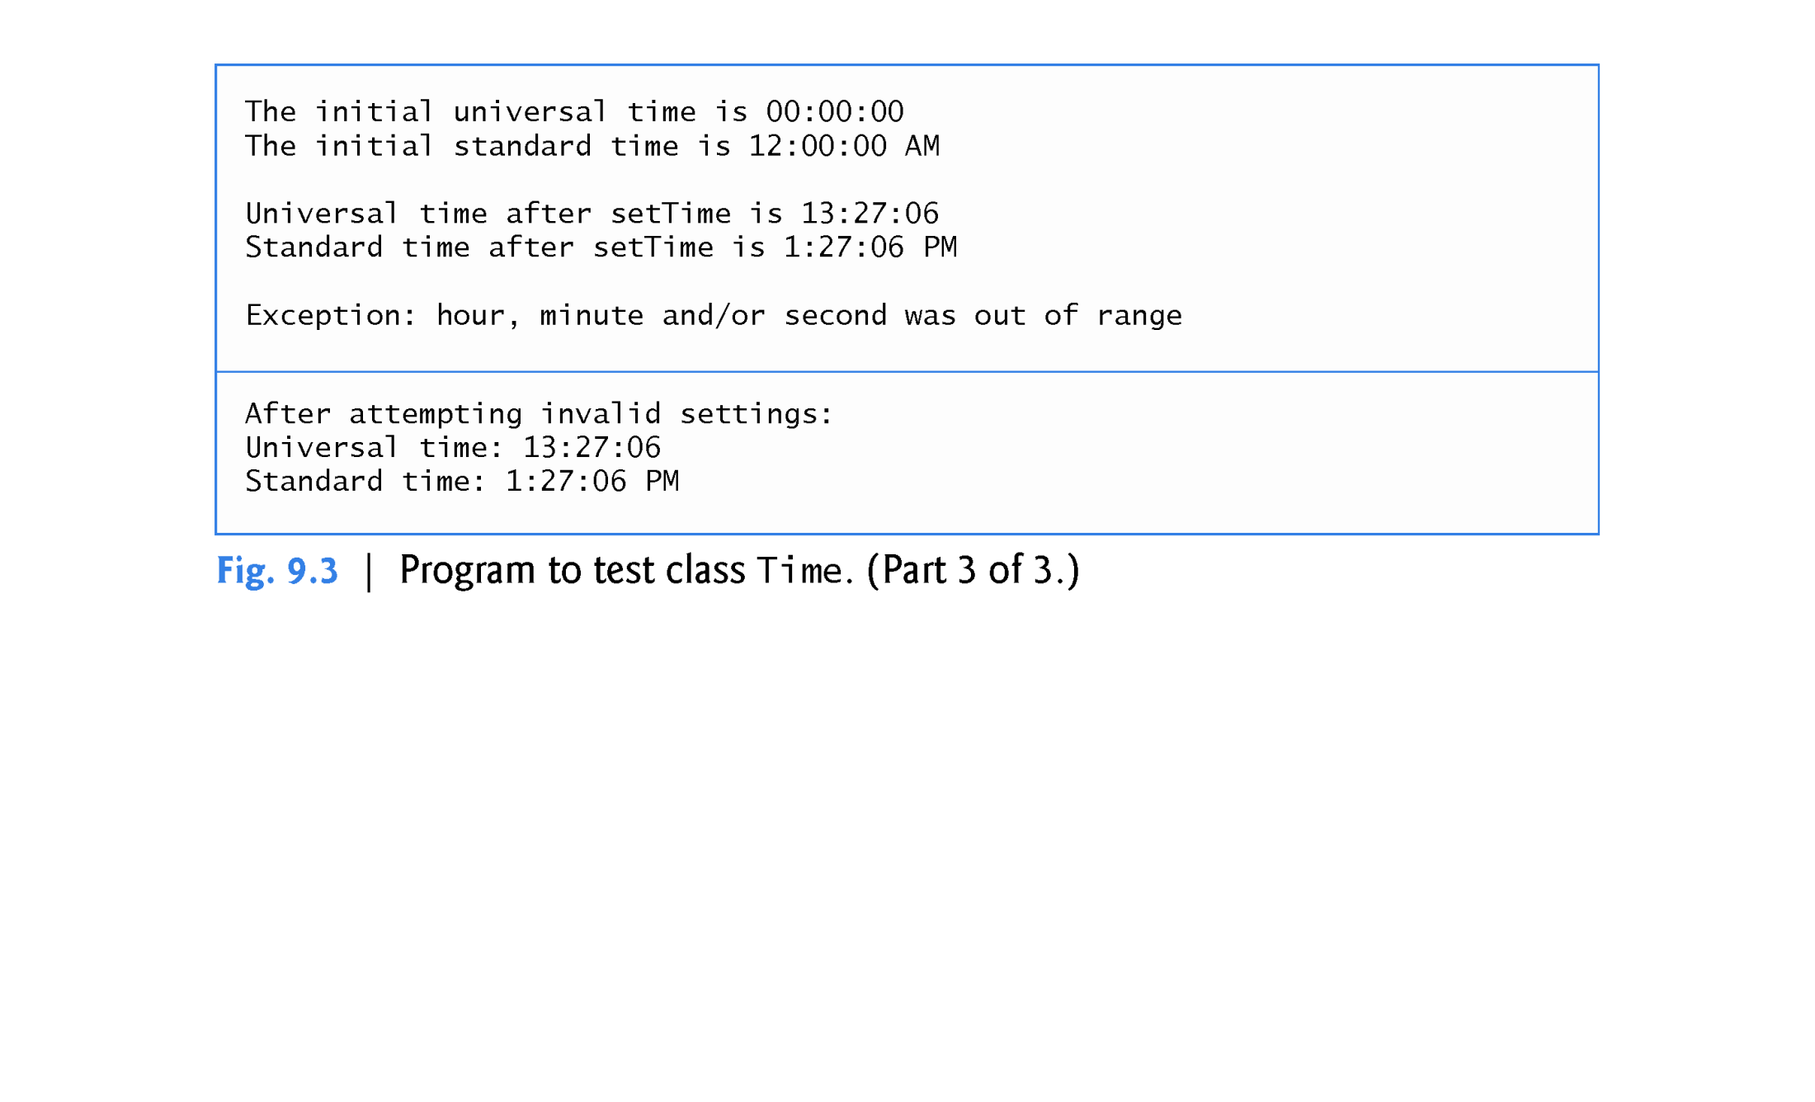

Slide 31
9.2 Time Class Case Study (cont.)
Object Size
People new to object-oriented programming often suppose that objects must be quite large because they contain data members and member functions.
Logically, this is true—you may think of objects as containing data and functions (and our discussion has certainly encouraged this view); physically, however, this is not true.

Slide 33
9.3 Class Scope and Accessing Class Members
A class’s data members and member functions belong to that class’s scope.
Nonmember functions are defined at global namespace scope, by default.
Within a class’s scope, class members are immediately accessible by all of that class’s member functions and can be referenced by name.
Outside a class’s scope, public class members are referenced through one of the handles on an object - an object name, a reference to an object or a pointer to an object.

Slide 34
9.3 Class Scope and Accessing Class Members (cont.)
Class Scope and Block Scope
If a member function defines a variable with the same name as a <static> variable with class scope, the class-scope variable is hidden in the function by the block-scope variable (the field is “shadowed” by the local variable)
Such a hidden variable can be accessed by preceding the variable name with the class name followed by the scope resolution operator (::).
Use this pointer with arrow operator
this -> hour = hour;

Slide 35
9.3 Class Scope and Accessing Class Members (cont.)
Dot (.) and Arrow (->) Member Selection Operators
The dot member selection operator (.) is preceded by an object’s name or with a reference to an object to access the object’s members.
The arrow member selection operator (->) is preceded by a pointer to an object to access the object’s members.

Slide 36
9.3 Class Scope and Accessing Class Members (cont.)
Accessing public Class Members Through Objects, References and Pointers
Consider an Account class that has a public setBalance member function. Given the following declarations:
Account account; //an Account object
//accountRef refers to an Account object
Account &accountRef = account;
//accountPtr points to an Account object
Account *accountPtr = &account;

Slide 37
9.3 Class Scope and Accessing Class Members (cont.)
You can invoke member function setBalance using the dot (.) and arrow (->) member selection operators as follows:
// call setBalance via the Account object
account.setBalance( 123.45 );
// call setBalance via a reference to the Account object
accountRef.setBalance( 123.45 );
// call setBalance via a pointer to the Account object
accountPtr -> setBalance( 123.45 );

Slide 38
9.4 Access Functions and Utility Functions
Access Functions
Access functions can read or display data.
A common use for access functions is to test the truth or falsity of conditions - such functions are often called predicate functions.
Utility Functions
A utility function (also called a helper function) is a private member function that supports the operation of the class’s other member functions.

Slide 39
9.5 Time Class Case Study: Constructors with Default Arguments
The program of Figs. 9.4–9.6 enhances class Time to demonstrate how arguments are implicitly passed to a constructor.
The constructor defined in Fig. 9.2 initialized hour, minute and second to 0 (i.e., midnight in universal time).
Like other functions, constructors can specify default arguments.

Slide 43
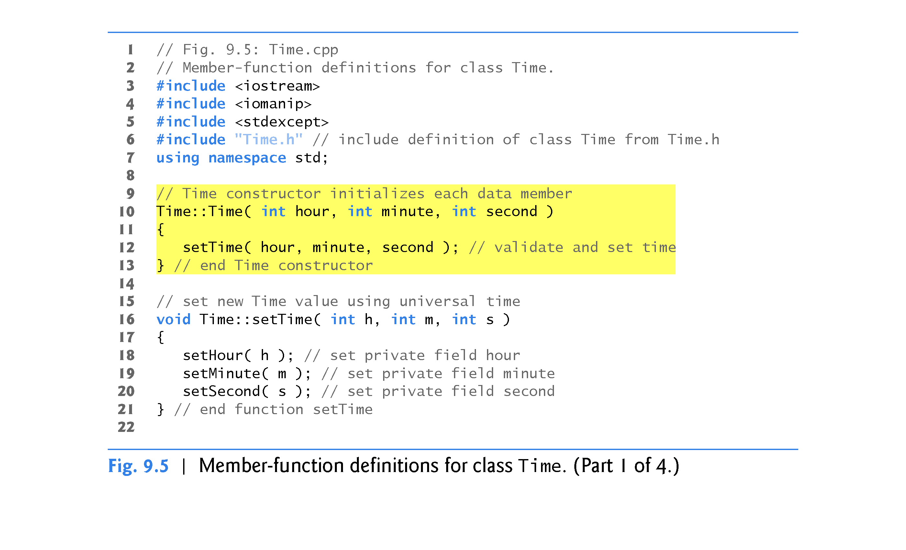

Slide 45
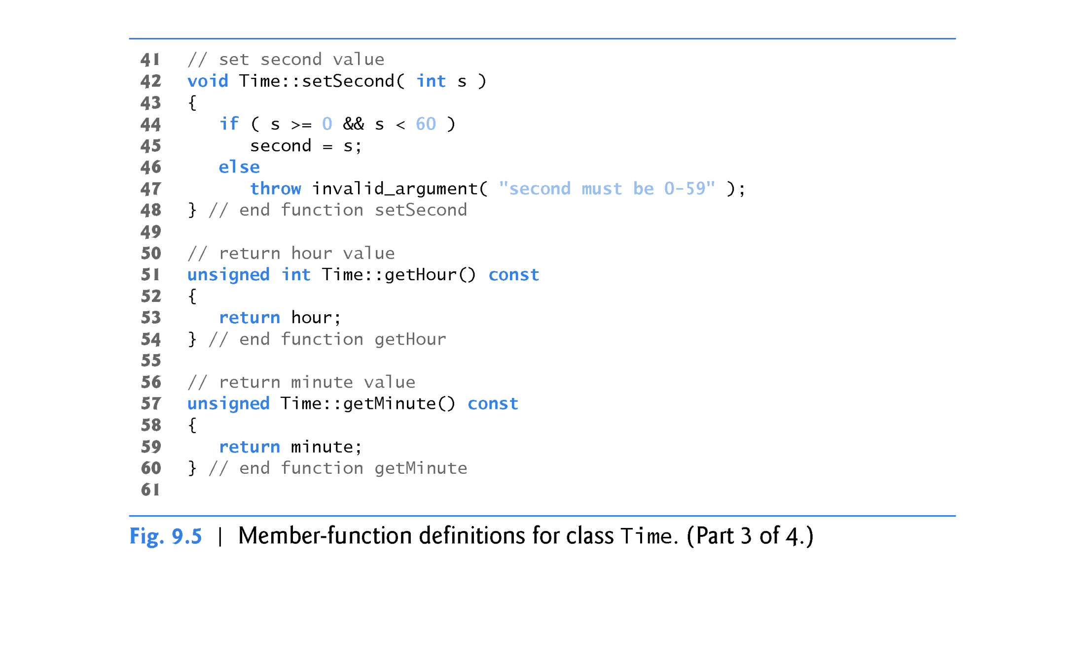

Slide 47
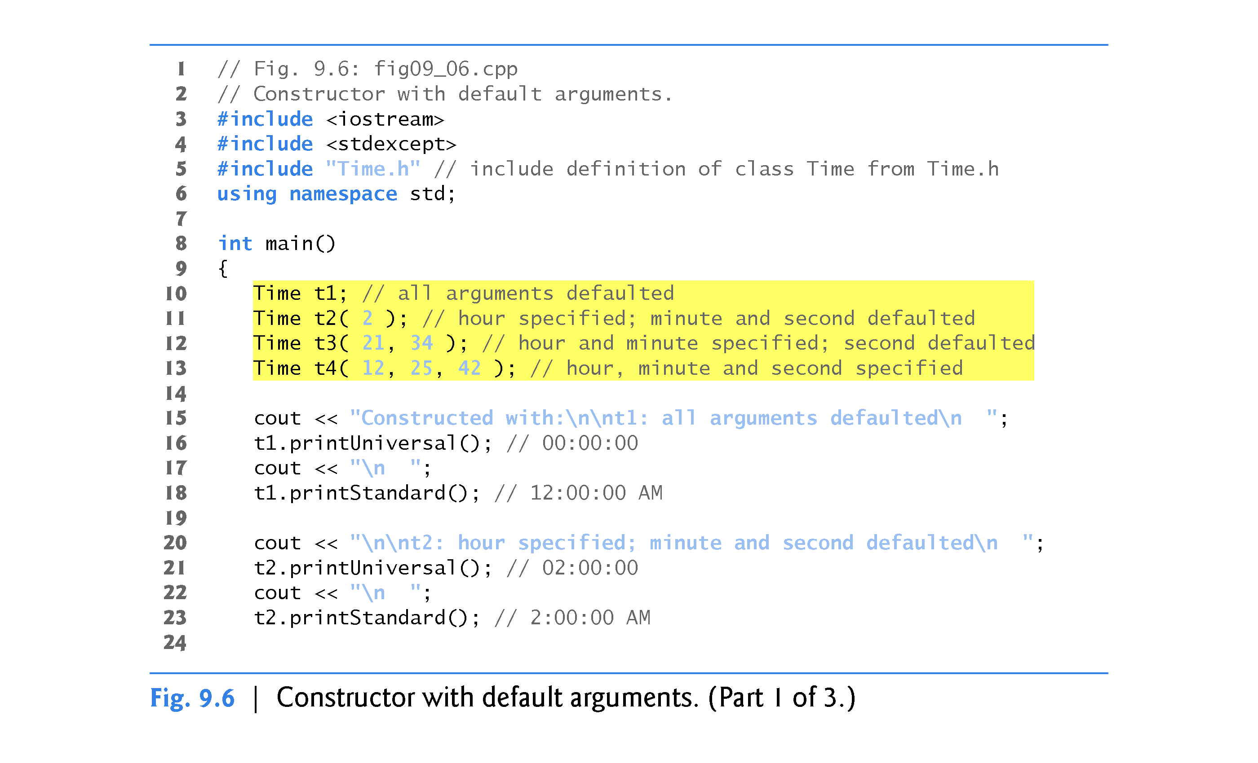

Slide 48
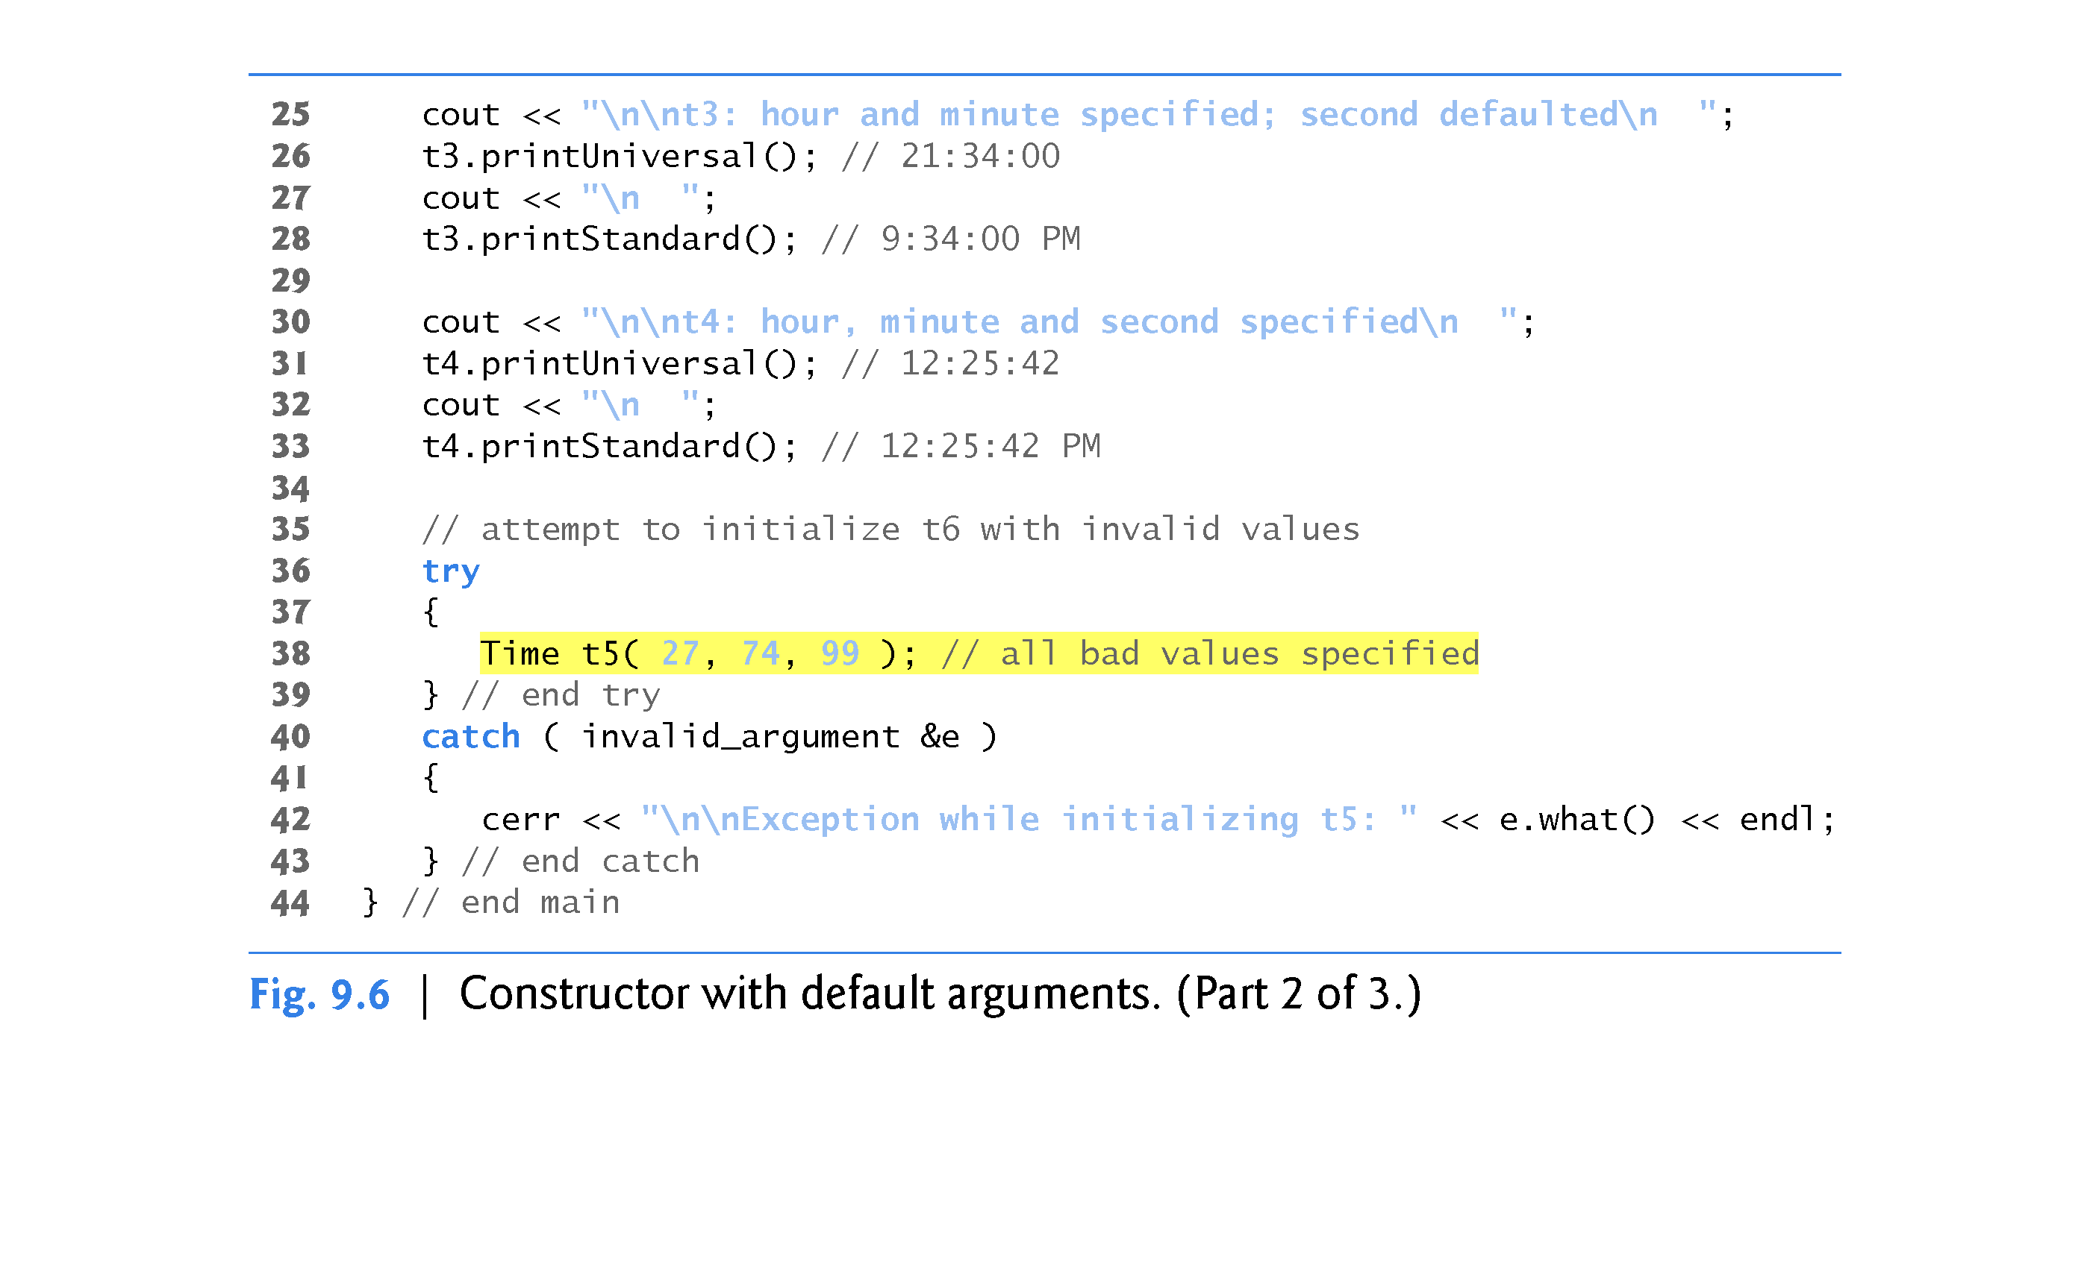

Slide 49
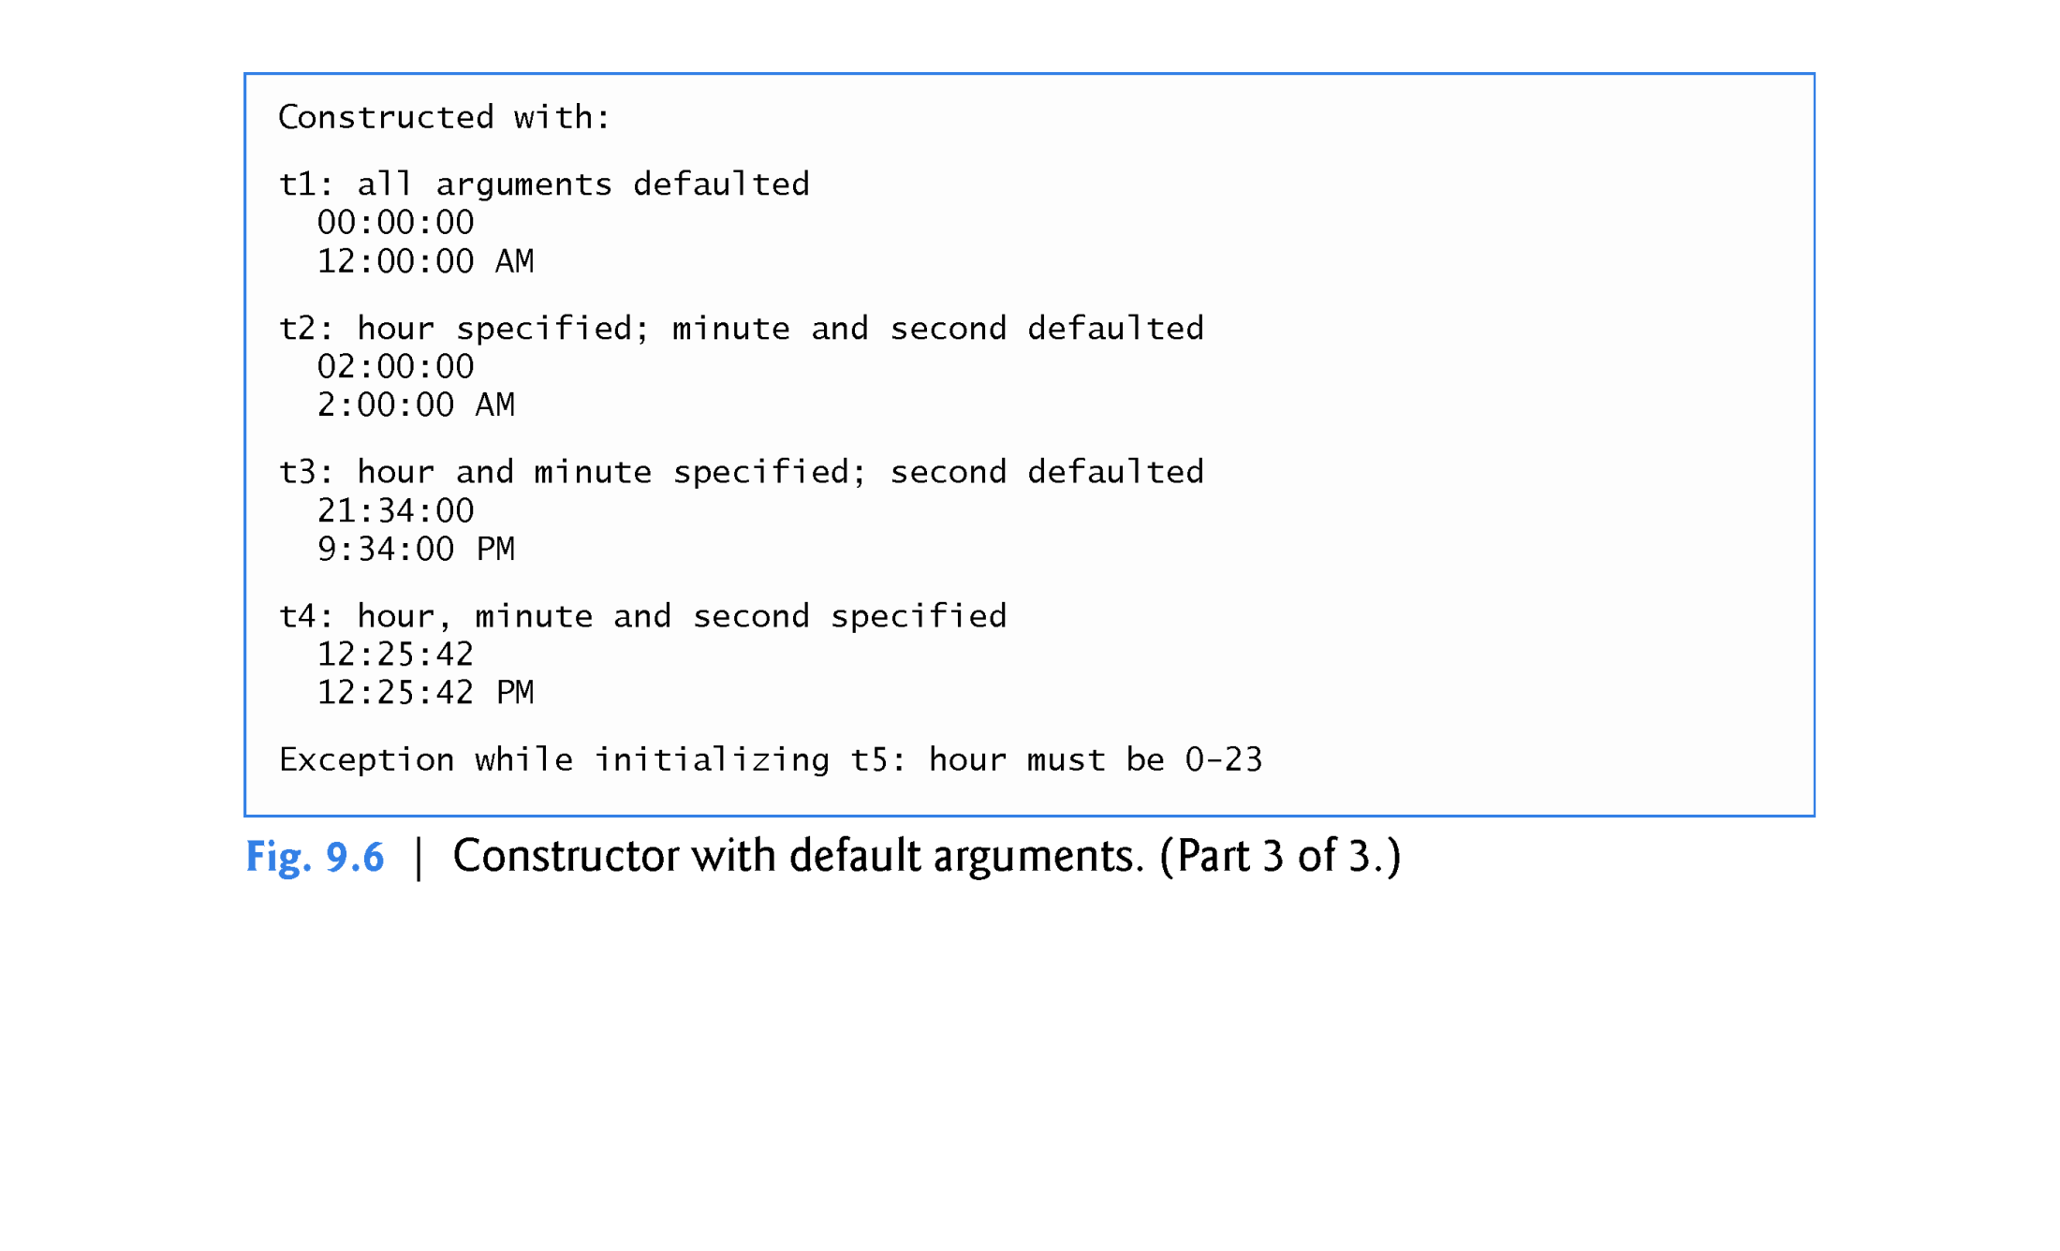

Slide 50
9.5 Time Class Case Study: Constructors with Default Arguments (cont.)
Notes Regarding Class Time’s Set and Get Functions and Constructor
Time’s set and get functions are called throughout the class’s body.
In each case, these functions could have accessed the class’s private data directly.
Consider changing the representation of the time from three int values (requiring 12 bytes of memory on systems with four-byte ints) to a single int value representing the total number of seconds that have elapsed since midnight (requiring only four bytes of memory).
If we made such a change, only the bodies of the functions that access the private data directly would need to change.
No need to modify the bodies of the other functions.

Slide 51
9.5 Time Class Case Study: Constructors with Default Arguments (cont.)
Designing the class in this manner reduces the likelihood of programming errors when altering the class’s implementation.
Duplicating statements in multiple functions or constructors makes changing the class’s internal data representation more difficult.

Slide 54
9.5 Time Class Case Study: Constructors with Default Arguments (cont.)
C++11: Using List Initializers to Call Constructors ( page 392 )
C++11 now provides a uniform initialization syntax called list initializers that can be used to initialize any variable. Lines 11–13 of Fig. 9.6 can be written using list initializers as follows:
Time t2{ 2 }; // hour specified; minute and second defaulted
Time t3{ 21, 34 }; // hour and minute specified; second defaulted
Time t4{ 12, 25, 42 }; // hour, minute and second specified
or
Time t2 = { 2 }; //doesn’t work in VS 2013!
Time t3 = { 21, 34 };
Time t4 = { 12, 25, 42 };
The form without the = is preferred (not my preference…)

Slide 55
9.5 Time Class Case Study: Constructors with Default Arguments (cont.)
C++11: Overloaded Constructors and Delegating Constructors
A class’s constructors and member functions can also be overloaded.
Overloaded constructors typically allow objects to be initialized with different types and/or numbers of arguments.
To overload a constructor, provide in the class definition a prototype for each version of the constructor, and provide a separate constructor definition for each overloaded version.
This also applies to the class’s member functions.

Slide 56
9.6 Time Class Case Study: Constructors with Default Arguments (cont.)
In Figs. 9.4–9.6, the Time constructor with three parameters had a default argument for each parameter. We could have defined that constructor instead as four overloaded constructors with the following prototypes:
Time(); //default hour, minute and second to 0
Time( int ); //initialize hour; default minute and second to 0
Time( int, int); //initialize hour and minute; default second to 0
Time( int, int, int ); //initialize hour, minute and second
C++11 now allows constructors to call other constructors in the same class.
The calling constructor is known as a delegating constructor—it delegates its work to another constructor.

Slide 57
9.5 Time Class Case Study: Constructors with Default Arguments (cont.)
The first three of the four Time constructors declared on the previous slide can delegate work to one with three int arguments, passing 0 as the default value for the extra parameters.
Use a member initializer with the name of the class as follows:
Time::Time()
Time( 0, 0, 0 ) //delegate to Time( int, int, int )
{
} // end constructor with no arguments
---------------------------------------------------------------------
Time::Time( int hour )
Time( hour, 0, 0 ) //delegate to Time( int, int, int )
{
} // end constructor with one argument
---------------------------------------------------------------------
Time::Time( int hour, int minute )
Time( hour, minute, 0 ) //delegate to Time( int, int, int )
{
} // end constructor with two arguments

Slide 58
9.6 Destructors
The name of the destructor for a class is the tilde character (~) followed by the class name.
Called implicitly when an object is destroyed.
The destructor itself does not actually release the object’s memory—it performs termination housekeeping before the object’s memory is reclaimed, so the memory may be reused to hold new objects.
Receives no parameters and returns no value.
May not specify a return type—not even void.
A class has one destructor.
A destructor must be public.
If you do not explicitly define a destructor, the compiler defines an “empty” destructor.

Slide 59
9.7 When Constructors and Destructors Are Called
Constructors and destructors are called implicitly.
The order in which these function calls occur depends on the order in which execution enters and leaves the scopes where the objects are instantiated.
Generally, destructor calls are made in the reverse order of the corresponding constructor calls
The storage classes of objects can alter the order in which destructors are called.

Slide 60
9.7 When Constructors and Destructors Are Called
Constructors and Destructors for Objects in Global Scope
Constructors are called for objects defined in global scope (also called global namespace scope) before any other function (including main) in that program begins execution (although the order of execution of global object constructors between files is not guaranteed).
The corresponding destructors are called when main terminates.
Function exit forces a program to terminate immediately and does not execute the destructors of local objects. [ exit(EXIT_FAILURE) ]
Function abort performs similarly to function exit but forces the program to terminate immediately, without allowing the destructors of any objects to be called.

Slide 61
9.7 When Constructors and Destructors Are Called (cont.)
Constructors and Destructors for Local Objects
Constructors and destructors for local objects are called each time execution enters and leaves the scope of the object.
Destructors are not called for local objects if the program terminates with a call to function exit or function abort.

Slide 62
9.7 When Constructors and Destructors Are Called (cont.)
Constructors and Destructors for static Local Objects
The constructor for a static local object is called only once, when execution first reaches the point where the object is defined—the corresponding destructor is called when main terminates or the program calls function exit.
Global and static objects are destroyed in the reverse order of their creation.
Destructors are not called for static objects if the program terminates with a call to function abort.

Slide 63
9.7 When Constructors and Destructors Are Called (cont.)
Demonstrating When Constructors and Destructors Are Called
The program of Figs. 9.7–9.9 demonstrates the order in which constructors and destructors are called for objects of class CreateAndDestroy (Fig. 9.7 and Fig. 9.8) of various storage classes in several scopes.

Slide 64
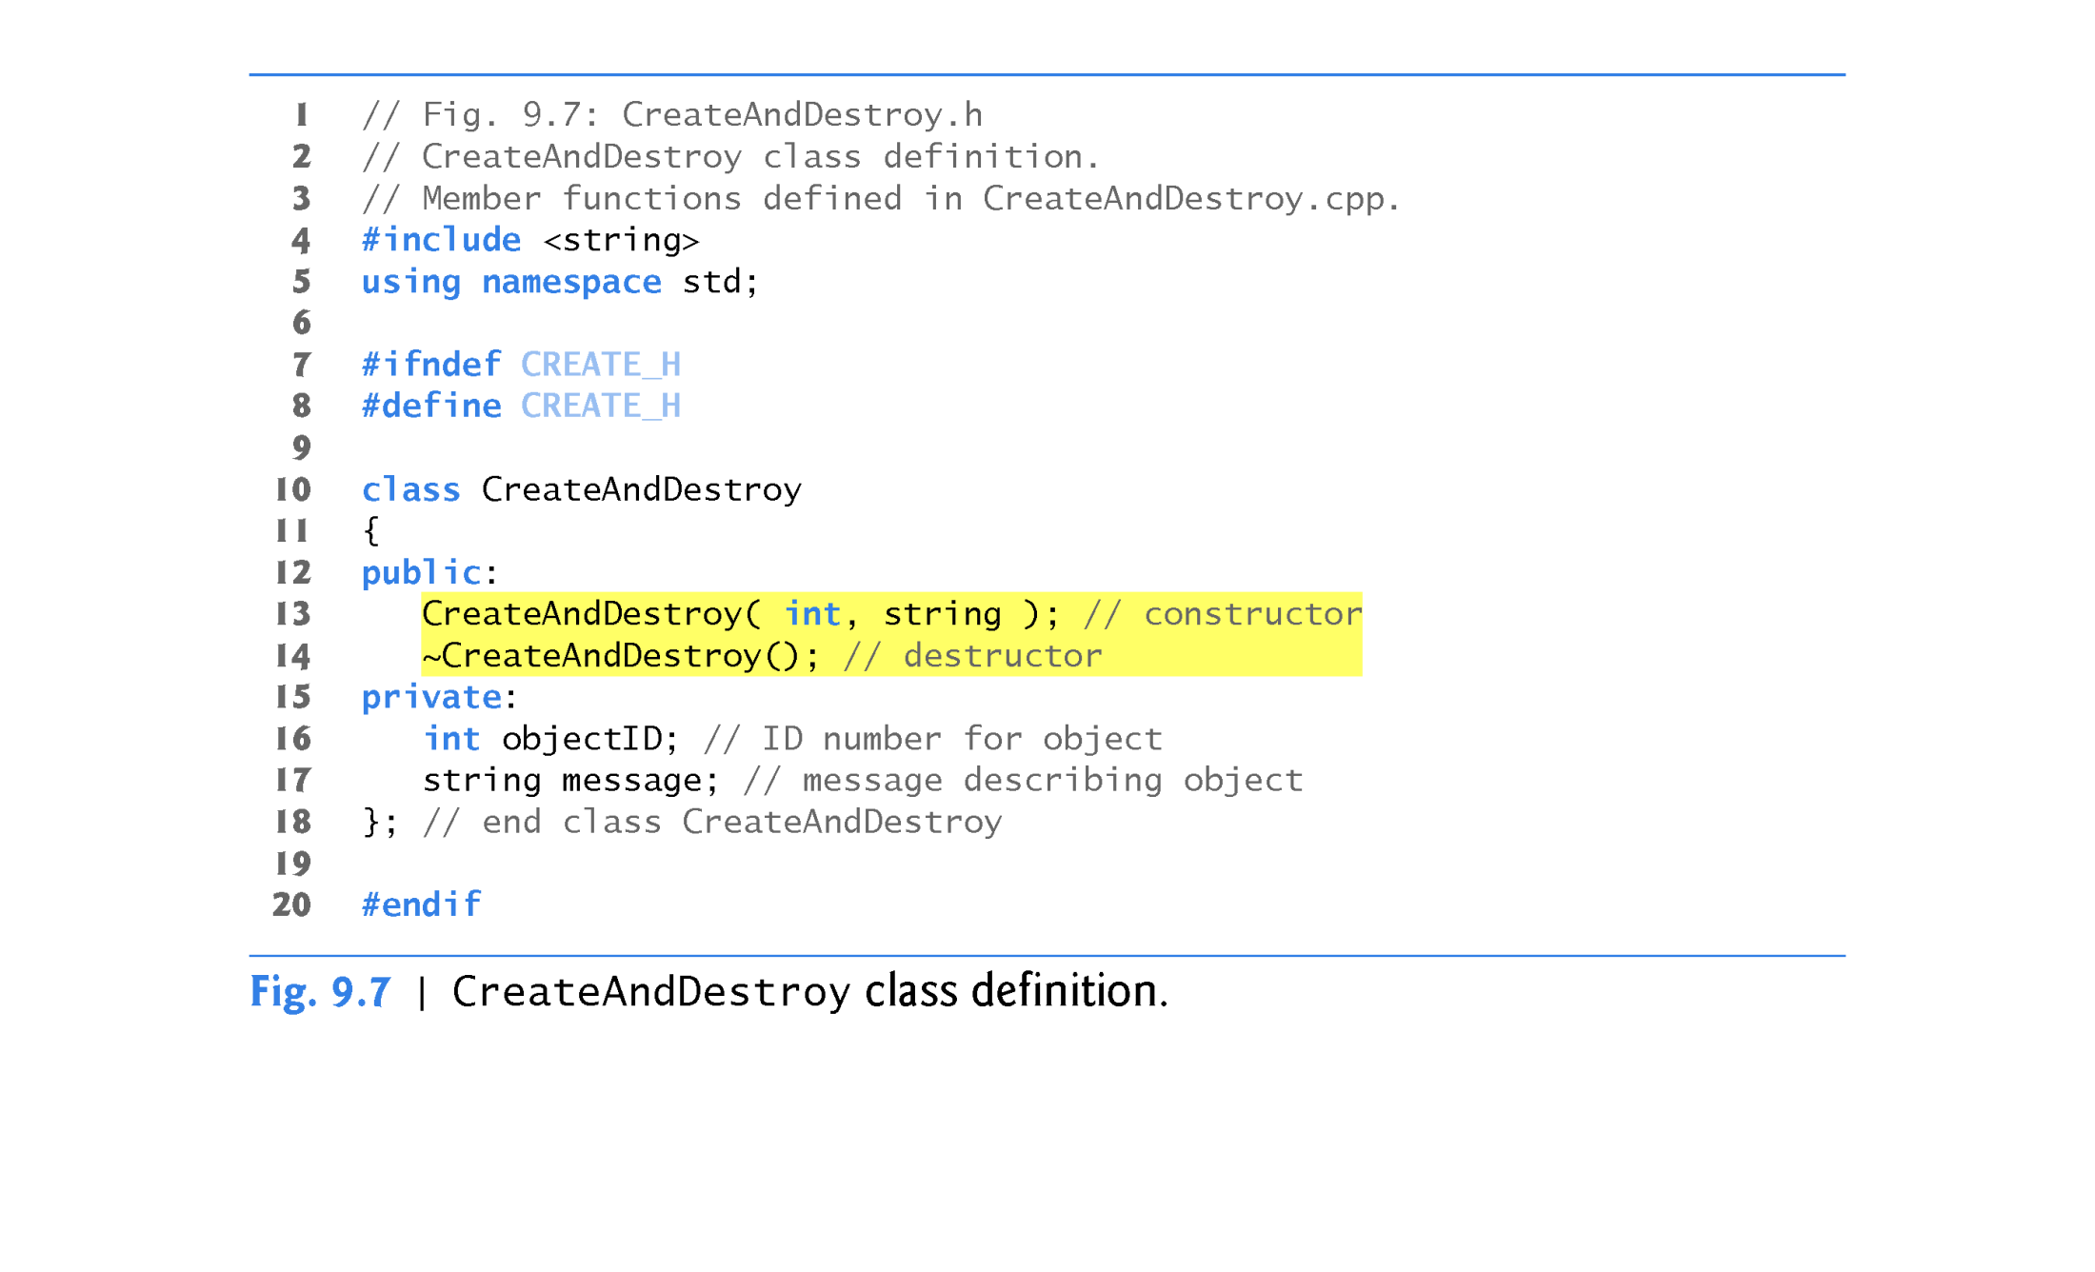

Slide 65
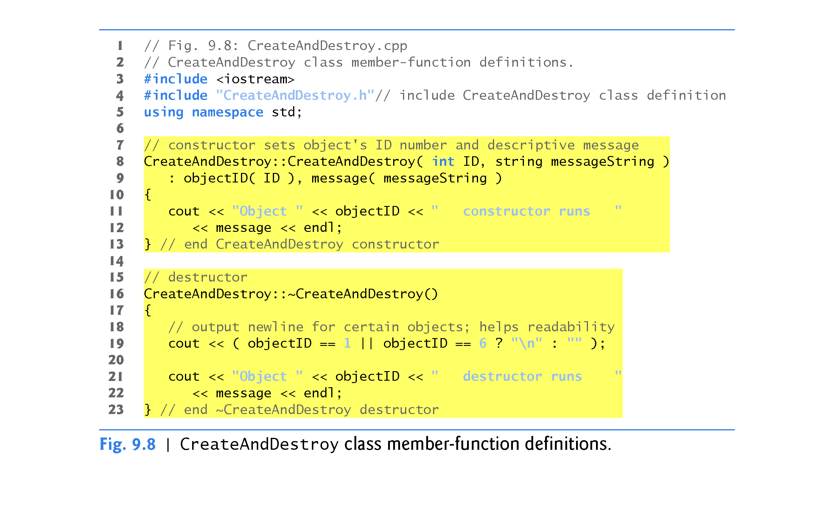

Slide 66
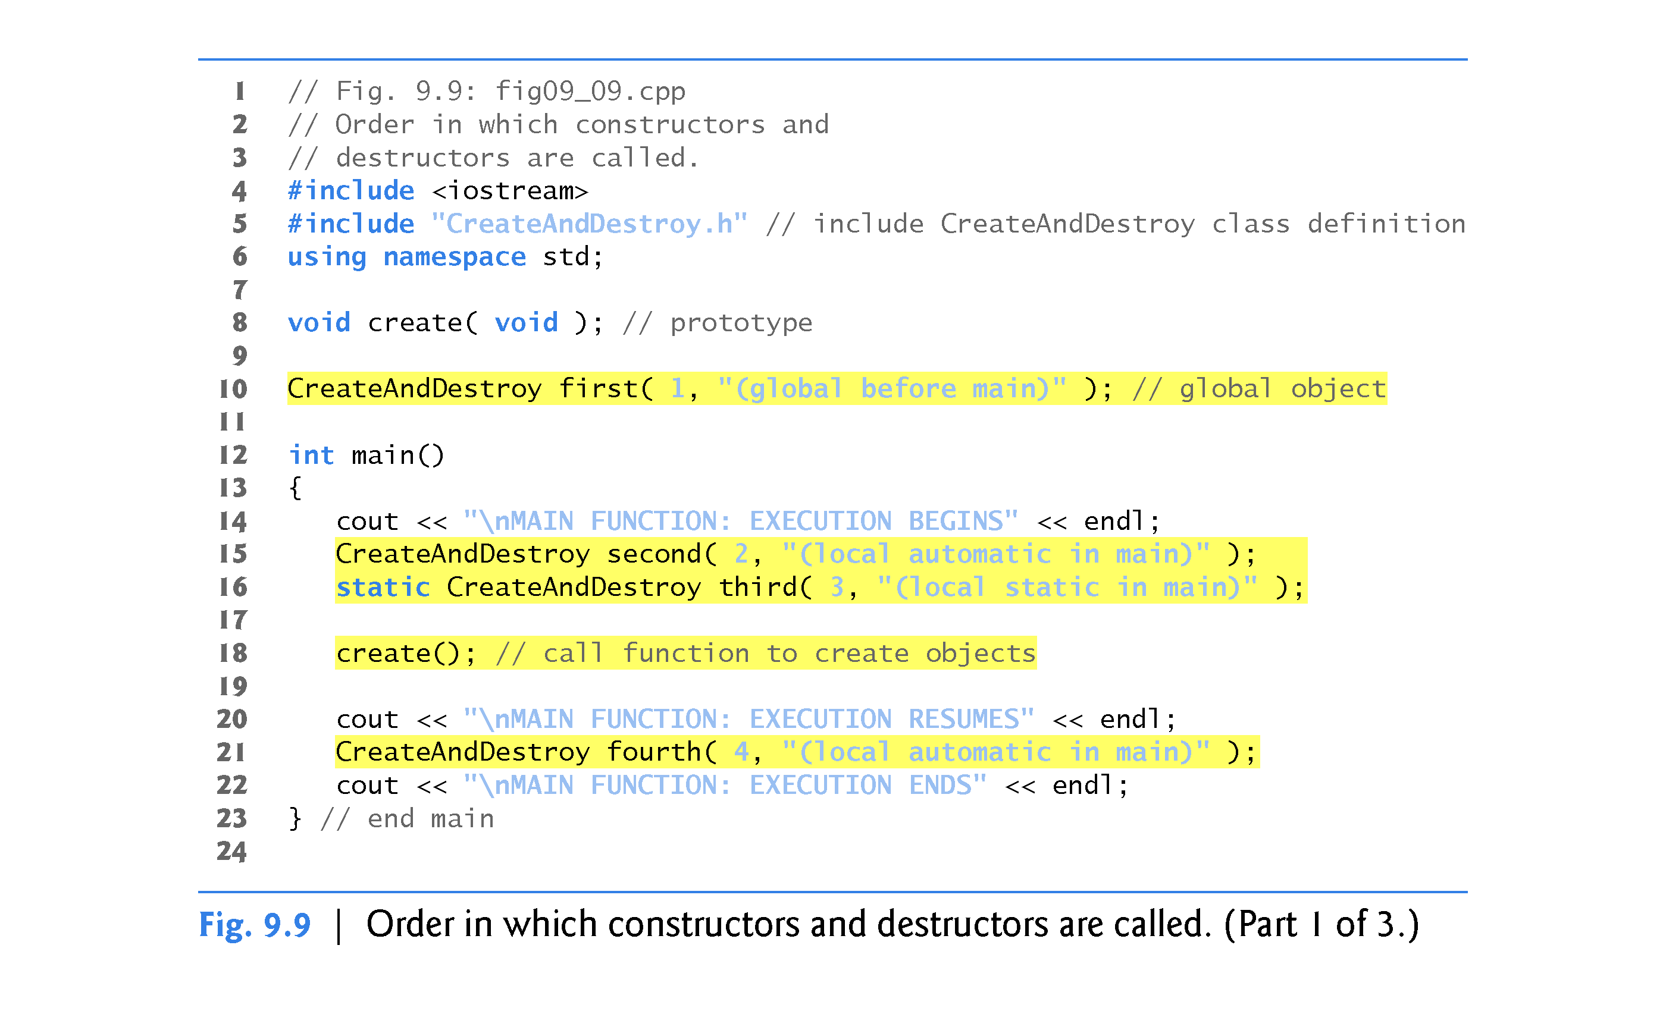

Slide 68
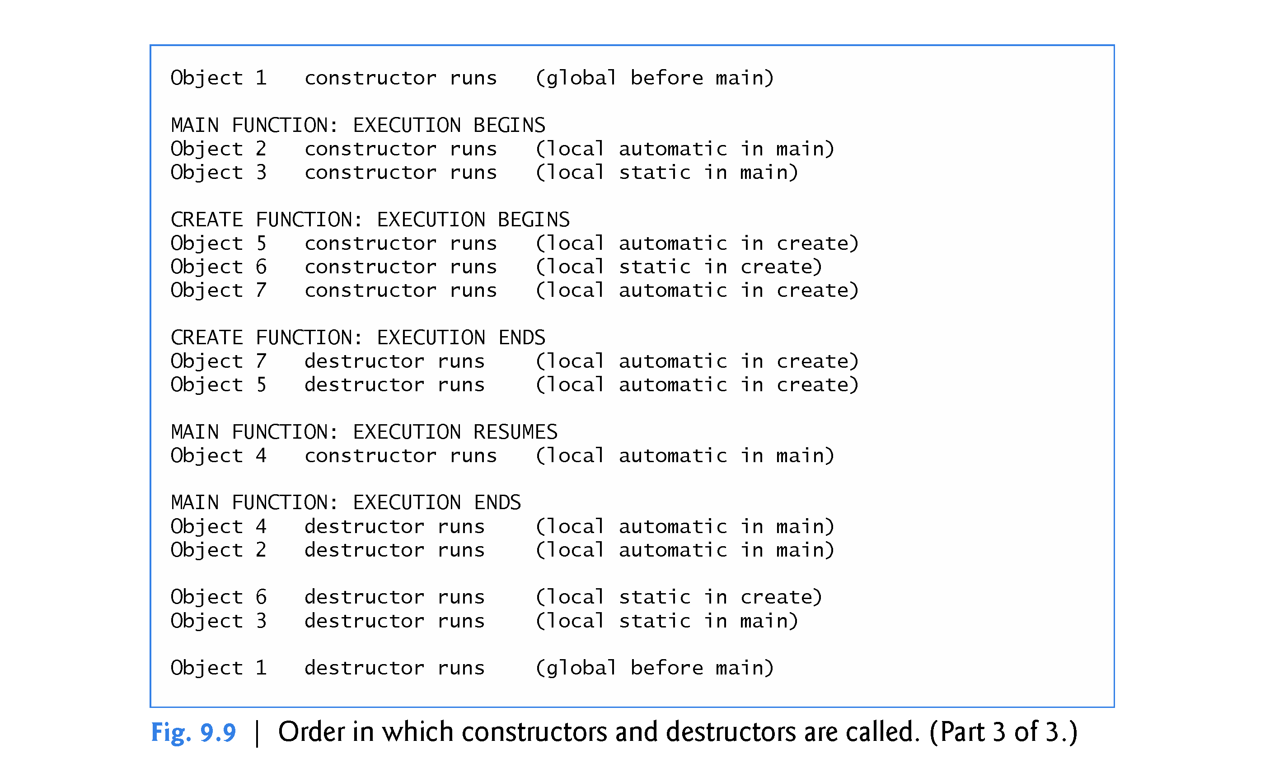

Slide 69
9.8 Time Class Case Study: A Subtle Trap—Returning a Reference or a Pointer to a private Data Member
A reference to an object is an alias for the name of the object and, hence, may be used on the left side of an assignment statement.
In this context, the reference makes a perfectly acceptable lvalue that can receive a value.
Unfortunately a public member function of a class can return a reference to a private data member of that class.
Such a reference return actually makes a call to that member function an alias for the private data member!
The function call can be used in any way that the private data member can be used, including as an lvalue in an assignment statement
The same problem would occur if a pointer to the private data were to be returned by the function.
If a function returns a reference that’s declared const, the reference is a non-modifiable lvalue and cannot be used to modify the data.

Slide 70
9.8 Time Class Case Study: A Subtle Trap—Returning a Reference or a Pointer to a private Data Member
The program of Figs. 9.10–9.12 uses a simplified Time class (Fig. 9.10 and Fig. 9.11) to demonstrate returning a reference to a private data member with member function badSetHour.

Slide 76
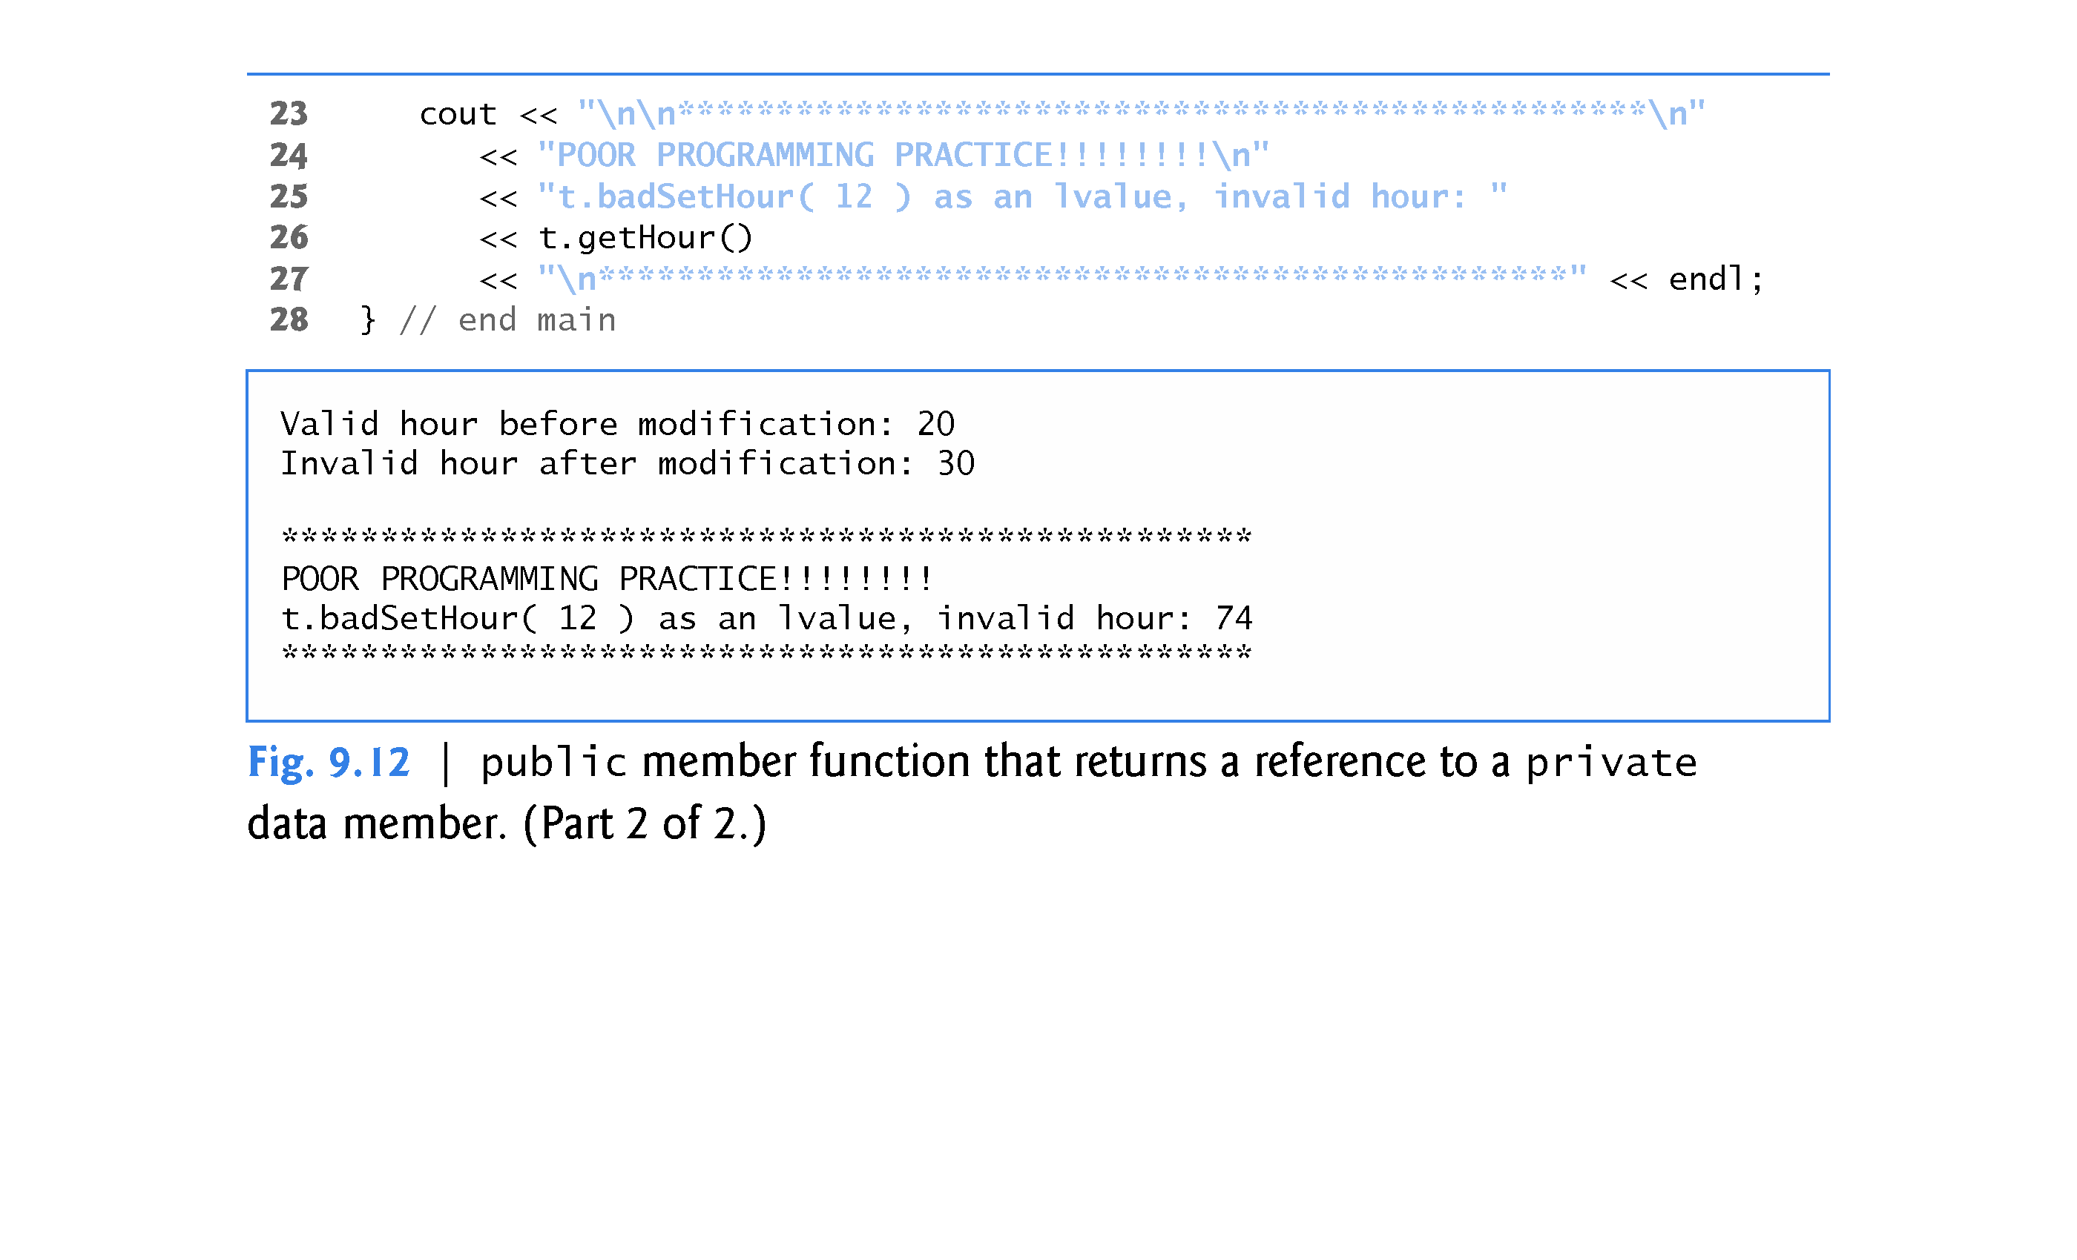

Slide 77
9.9 Default Memberwise Assignment
The assignment operator (=) can be used to assign an object to another object of the same type.
By default, such assignment is performed by memberwise assignment (also called copy assignment).
Each data member of the object on the right of the assignment operator is assigned individually to the same data member in the object on the left of the assignment operator.
[Caution: Memberwise assignment can cause serious problems when used with a class whose data members contain pointers to dynamically allocated memory; we discuss these problems in Chapter 10 and show how to deal with them.]

Slide 80
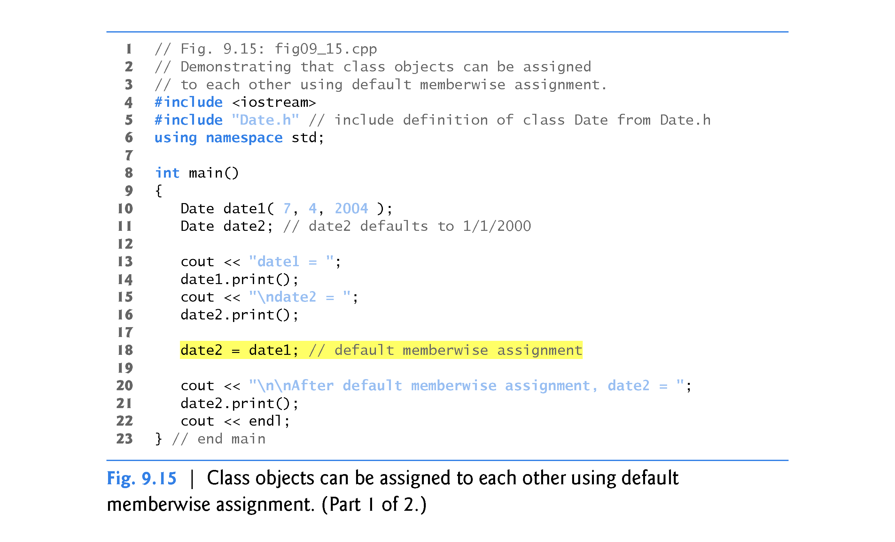

Slide 81
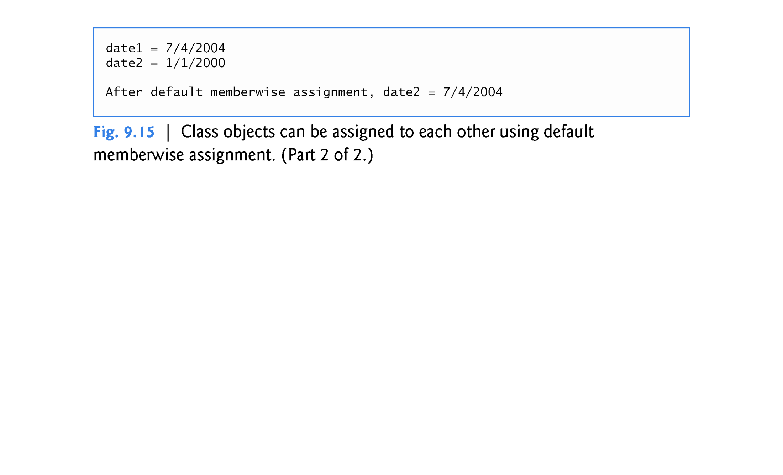

Slide 82
9.9 Default Memberwise Assignment (cont.)
Objects may be passed as function arguments and may be returned from functions.
Such passing and returning is performed using pass-by-value by default—a copy of the object is passed or returned.
C++ creates a new object and uses a copy constructor to copy the original object’s values into the new object.
For each class, the compiler provides a default copy constructor that copies each member of the original object into the corresponding member of the new object.
Copy constructors can cause serious problems when used with a class whose data members contain pointers to dynamically allocated memory.
Chapter 10 discusses customized copy constructors.

Slide 83
9.10 const Objects and const Member Functions
Some objects need to be modifiable and some do not.
You may use keyword const to specify that an object is not modifiable and that any attempt to modify the object should result in a compilation error.
The statement
const Time noon( 12, 0, 0 );
declares a const object noon of class Time and initializes it to 12 noon. It’s possible to instantiate const and non- const objects of the same class.

Slide 86
9.10 const Objects and const Member Functions (cont.)
C++ disallows member function calls for const objects unless the member functions themselves are also declared const.
This is true even for get member functions that do not modify the object.
This is also a key reason that we’ve declared as const all member-functions that do not modify the objects on which they’re called.
A member function is specified as const both in its prototype by inserting the keyword const after the function’s parameter list and, in the case of the function definition, before the left brace that begins the function body.

Slide 90
9.10 const Objects and const Member Functions (cont.)
A constructor must be allowed to modify an object so that the object can be initialized properly.
A destructor must be able to perform its termination housekeeping chores before an object’s memory is reclaimed by the system.
Attempting to declare a constructor or destructor const is a compilation error.
The “constness” of a const object is enforced from the time the constructor completes initialization of the object until that object’s destructor is called.

Slide 91
9.10 const Objects and const Member Functions (cont.)
Using const and Non-const Member Functions
The program of Fig. 9.16 uses class Time from Figs. 9.4–9.5, but removes const from function printStandard’s prototype and definition so that we can show a compilation error.

Slide 92
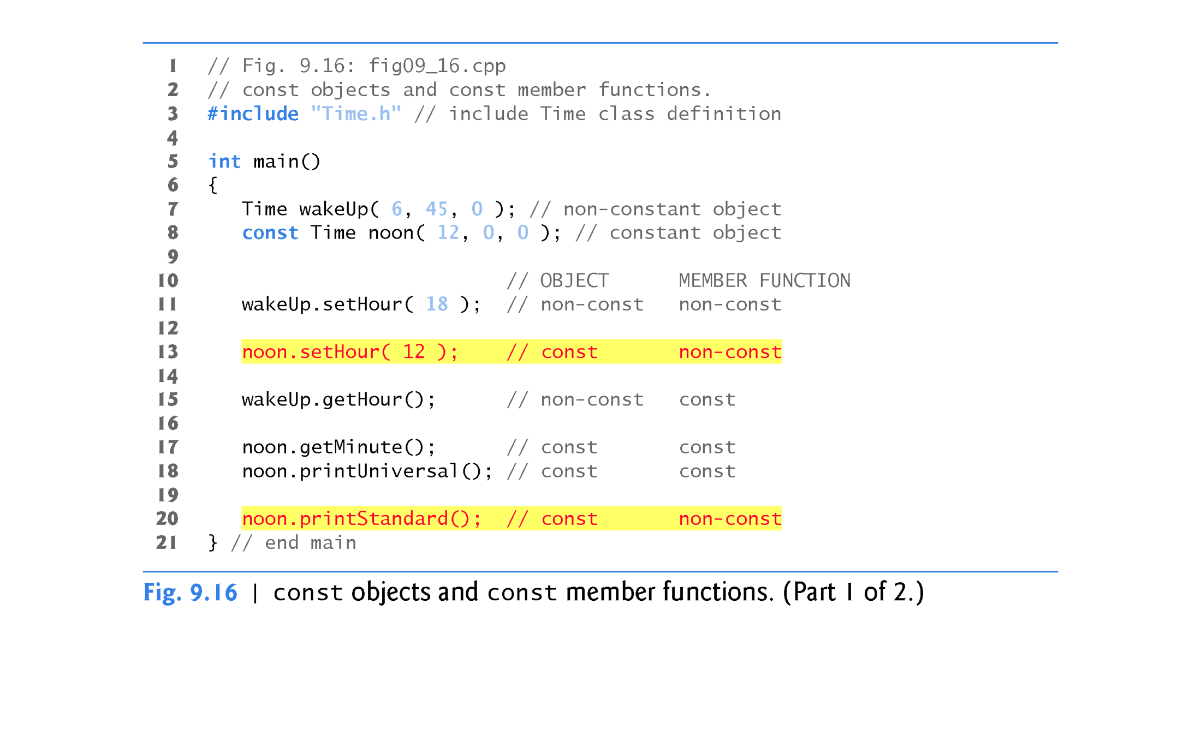

Slide 93
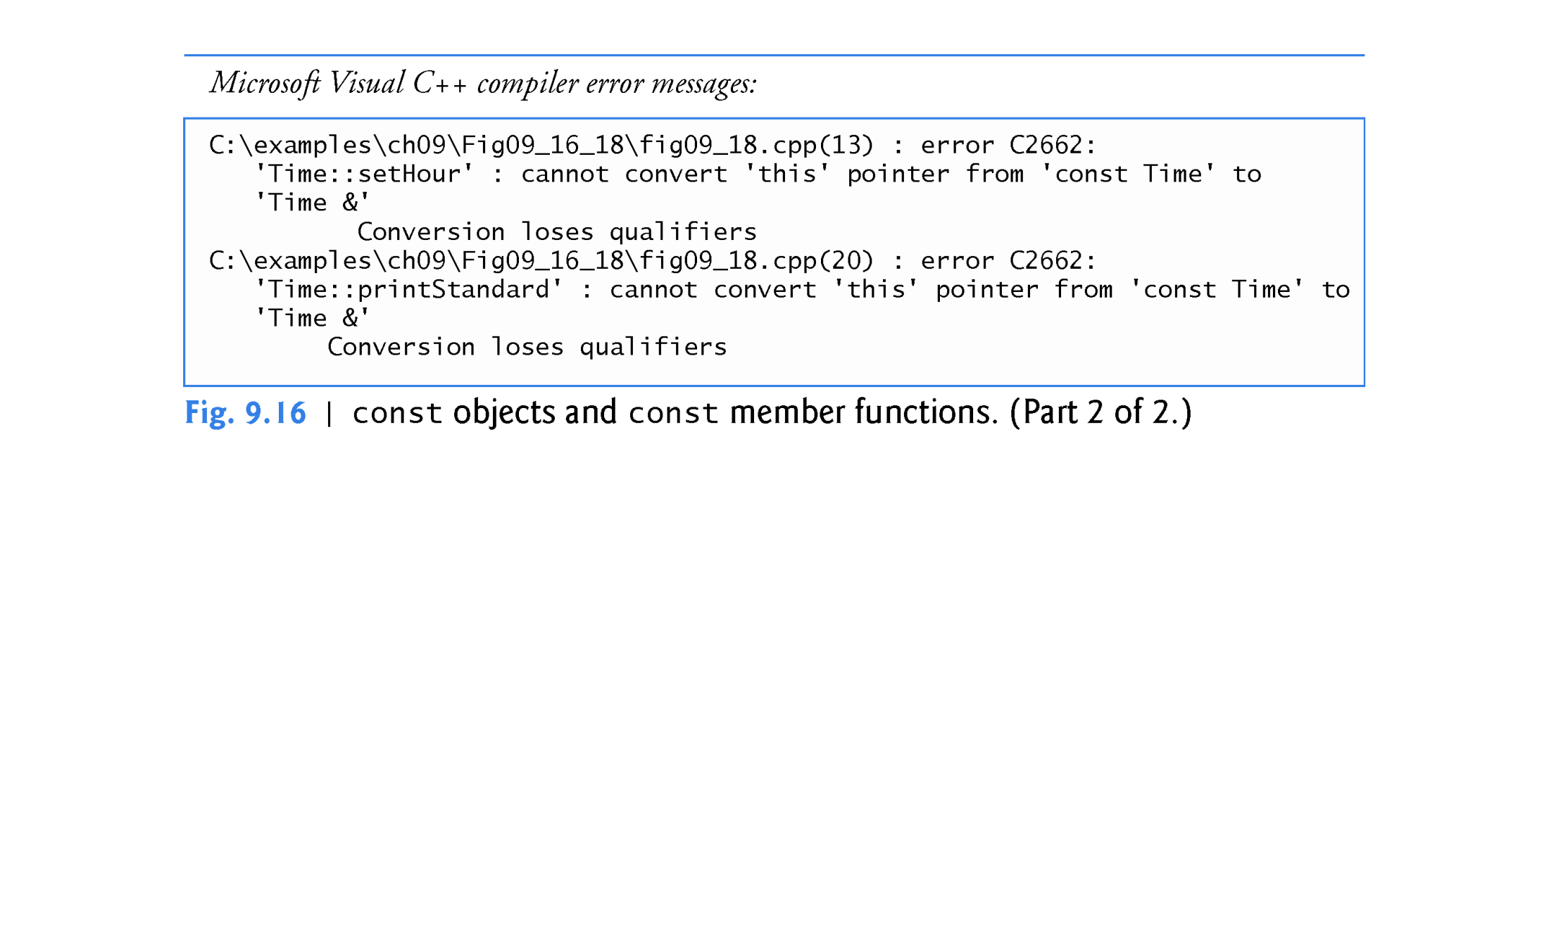

Slide 94
9.11 Composition: Objects as Members of Classes
An AlarmClock object needs to know when it’s supposed to sound its alarm, so why not include a Time object as a member of the AlarmClock class?
Such a capability is called composition and is sometimes referred to as a has-a relationship—a class can have objects of other classes as members.
The next program uses classes Date (Figs. 9.17–9.18) and Employee (Figs. 9.19–9.20) to demonstrate composition.

Slide 101
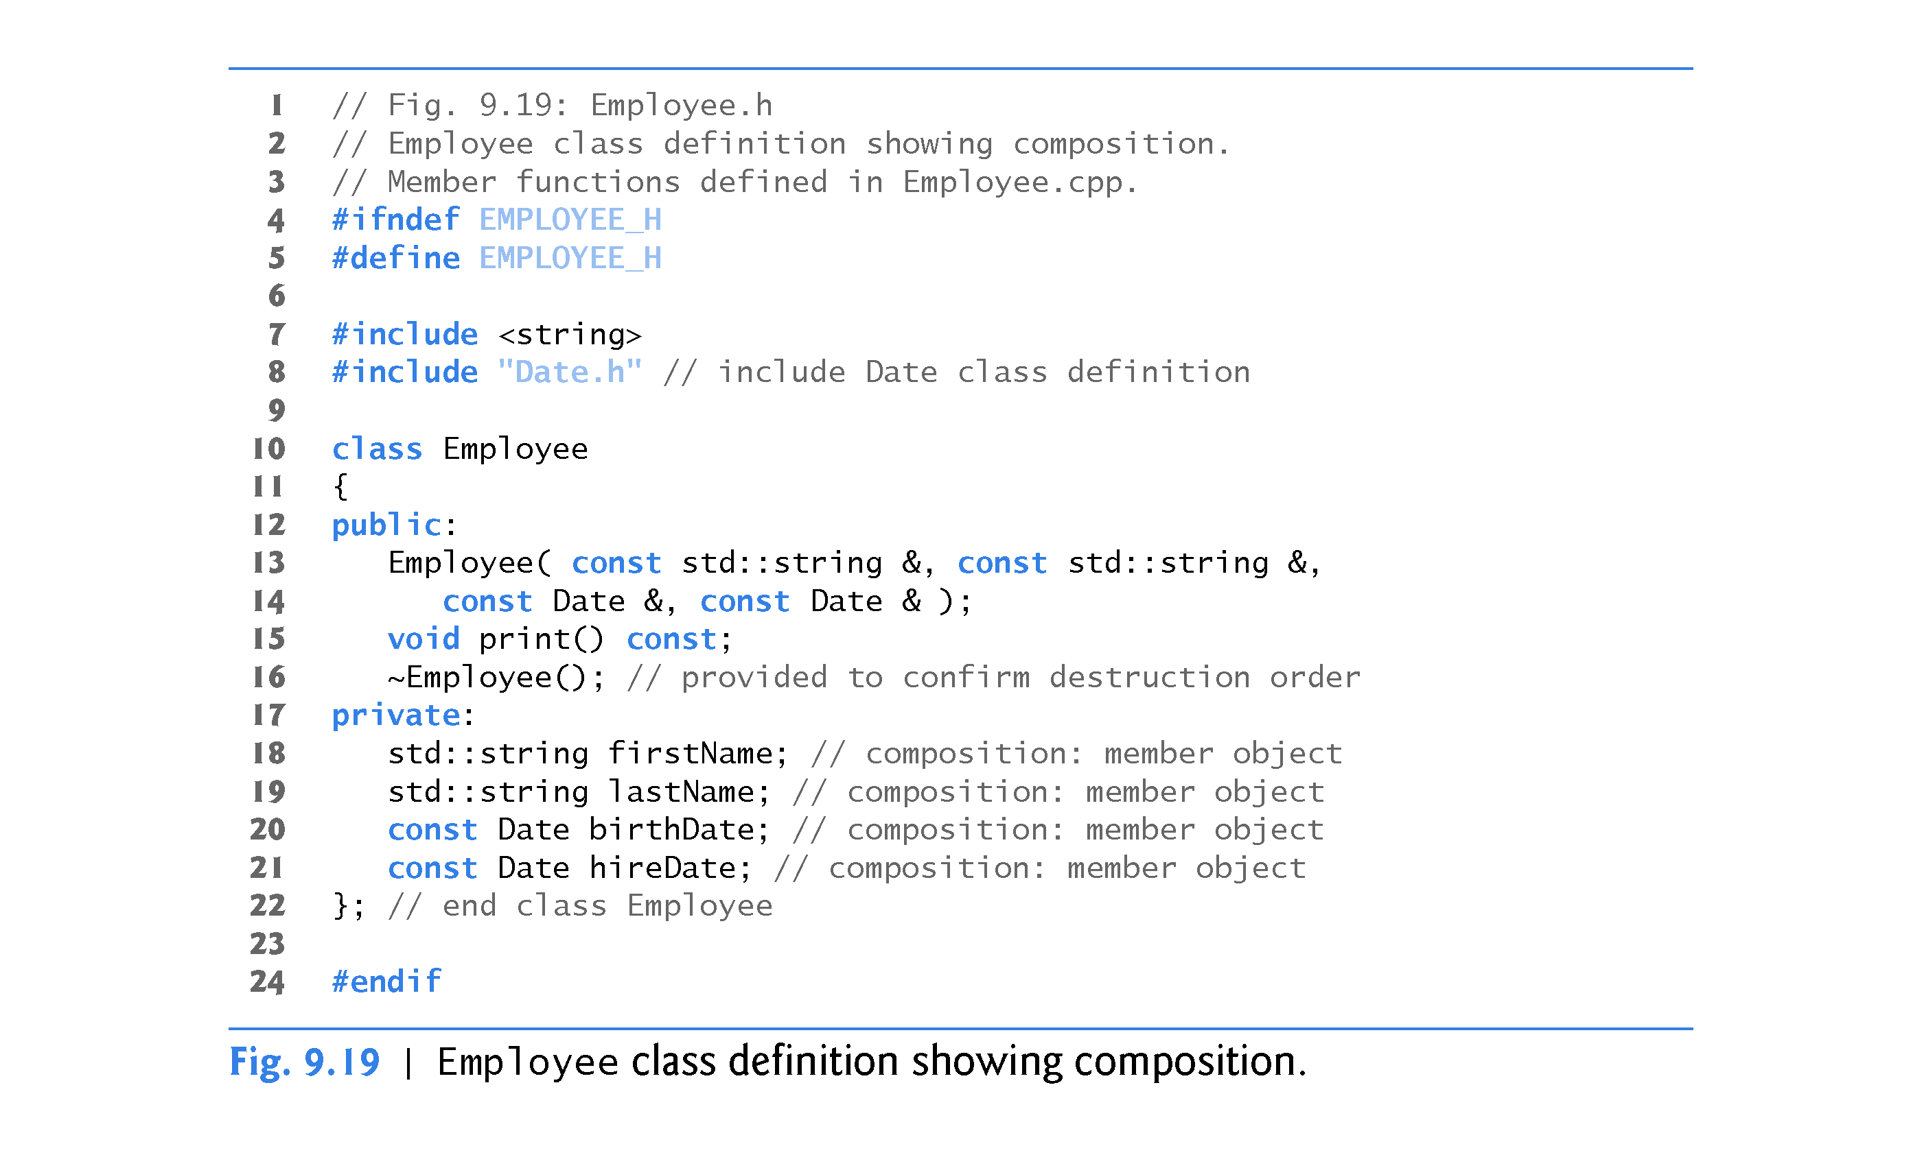

Slide 104
9.11 Composition: Objects as Members of Classes (cont.)
Employee Constructor’s Member Initializer List
The colon (:) following the constructor’s header (Fig. 9.20, line 12) begins the member initializer list.
The member initializers specify the Employee constructor parameters being passed to the constructors of the string and Date data members.
Again, member initializers are separated by commas.
The order of the member initializers does not matter.
They’re executed in the order that the member objects are declared in class Employee.

Slide 106
9.11 Composition: Objects as Members of Classes (cont.)
Date Class’s Default Copy Constructor
As we mentioned in Section 9.9, the compiler provides each class with a default copy constructor that copies each data member of the constructor’s argument object into the corresponding member of the object being initialized.
Chapter 10 discusses how you can define customized copy constructors. Object::Object(const Object &obj);

Slide 107
9.11 Composition: Objects as Members of Classes (cont.)
Testing Classes Date and Employee
Figure 9.21 creates two Date objects (lines 10–11) and passes them as arguments to the constructor of the Employee object created in line 12.
Line 15 outputs the Employee object’s data.
When each Date object is created in lines 10–11, the Date constructor defined in lines 11–25 of Fig. 9.18 displays a line of output to show that the constructor was called (see the first two lines of the sample output).

Slide 108
9.11 Composition: Objects as Members of Classes (cont.)
[Note: Line 12 of Fig. 9.21 causes two additional Date constructor calls that do not appear in the program’s output. When each of the Employee’s Date member objects is initialized in the Employee constructor’s member-initializer list (Fig. 9.20, lines 14–15), the default copy constructor for class Date is called. Since this constructor is defined implicitly by the compiler, it does not contain any output statements to demonstrate when it’s called.]

Slide 109
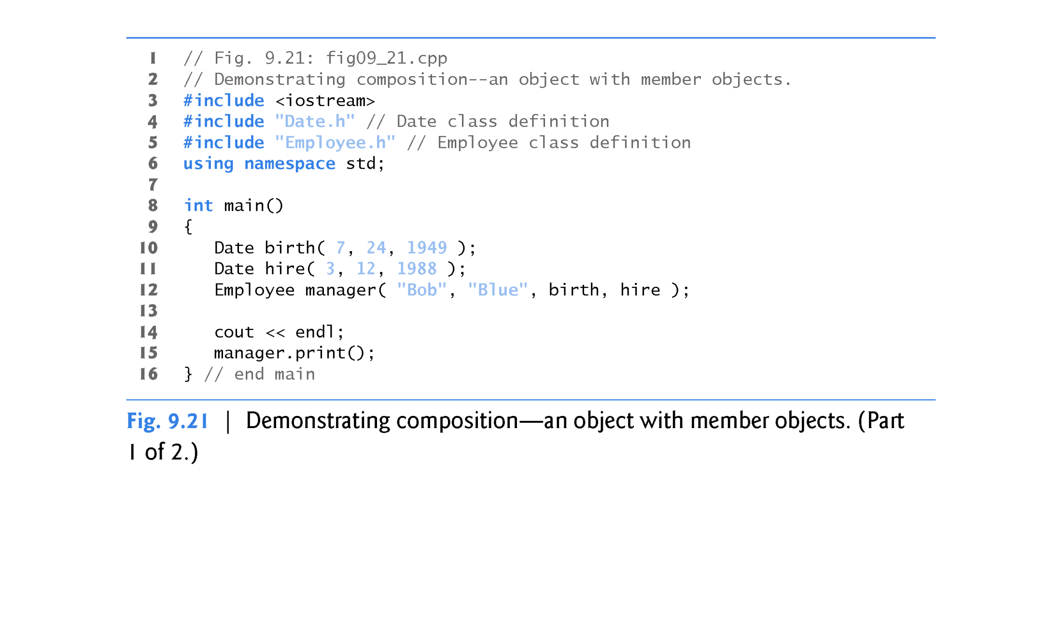

Slide 110
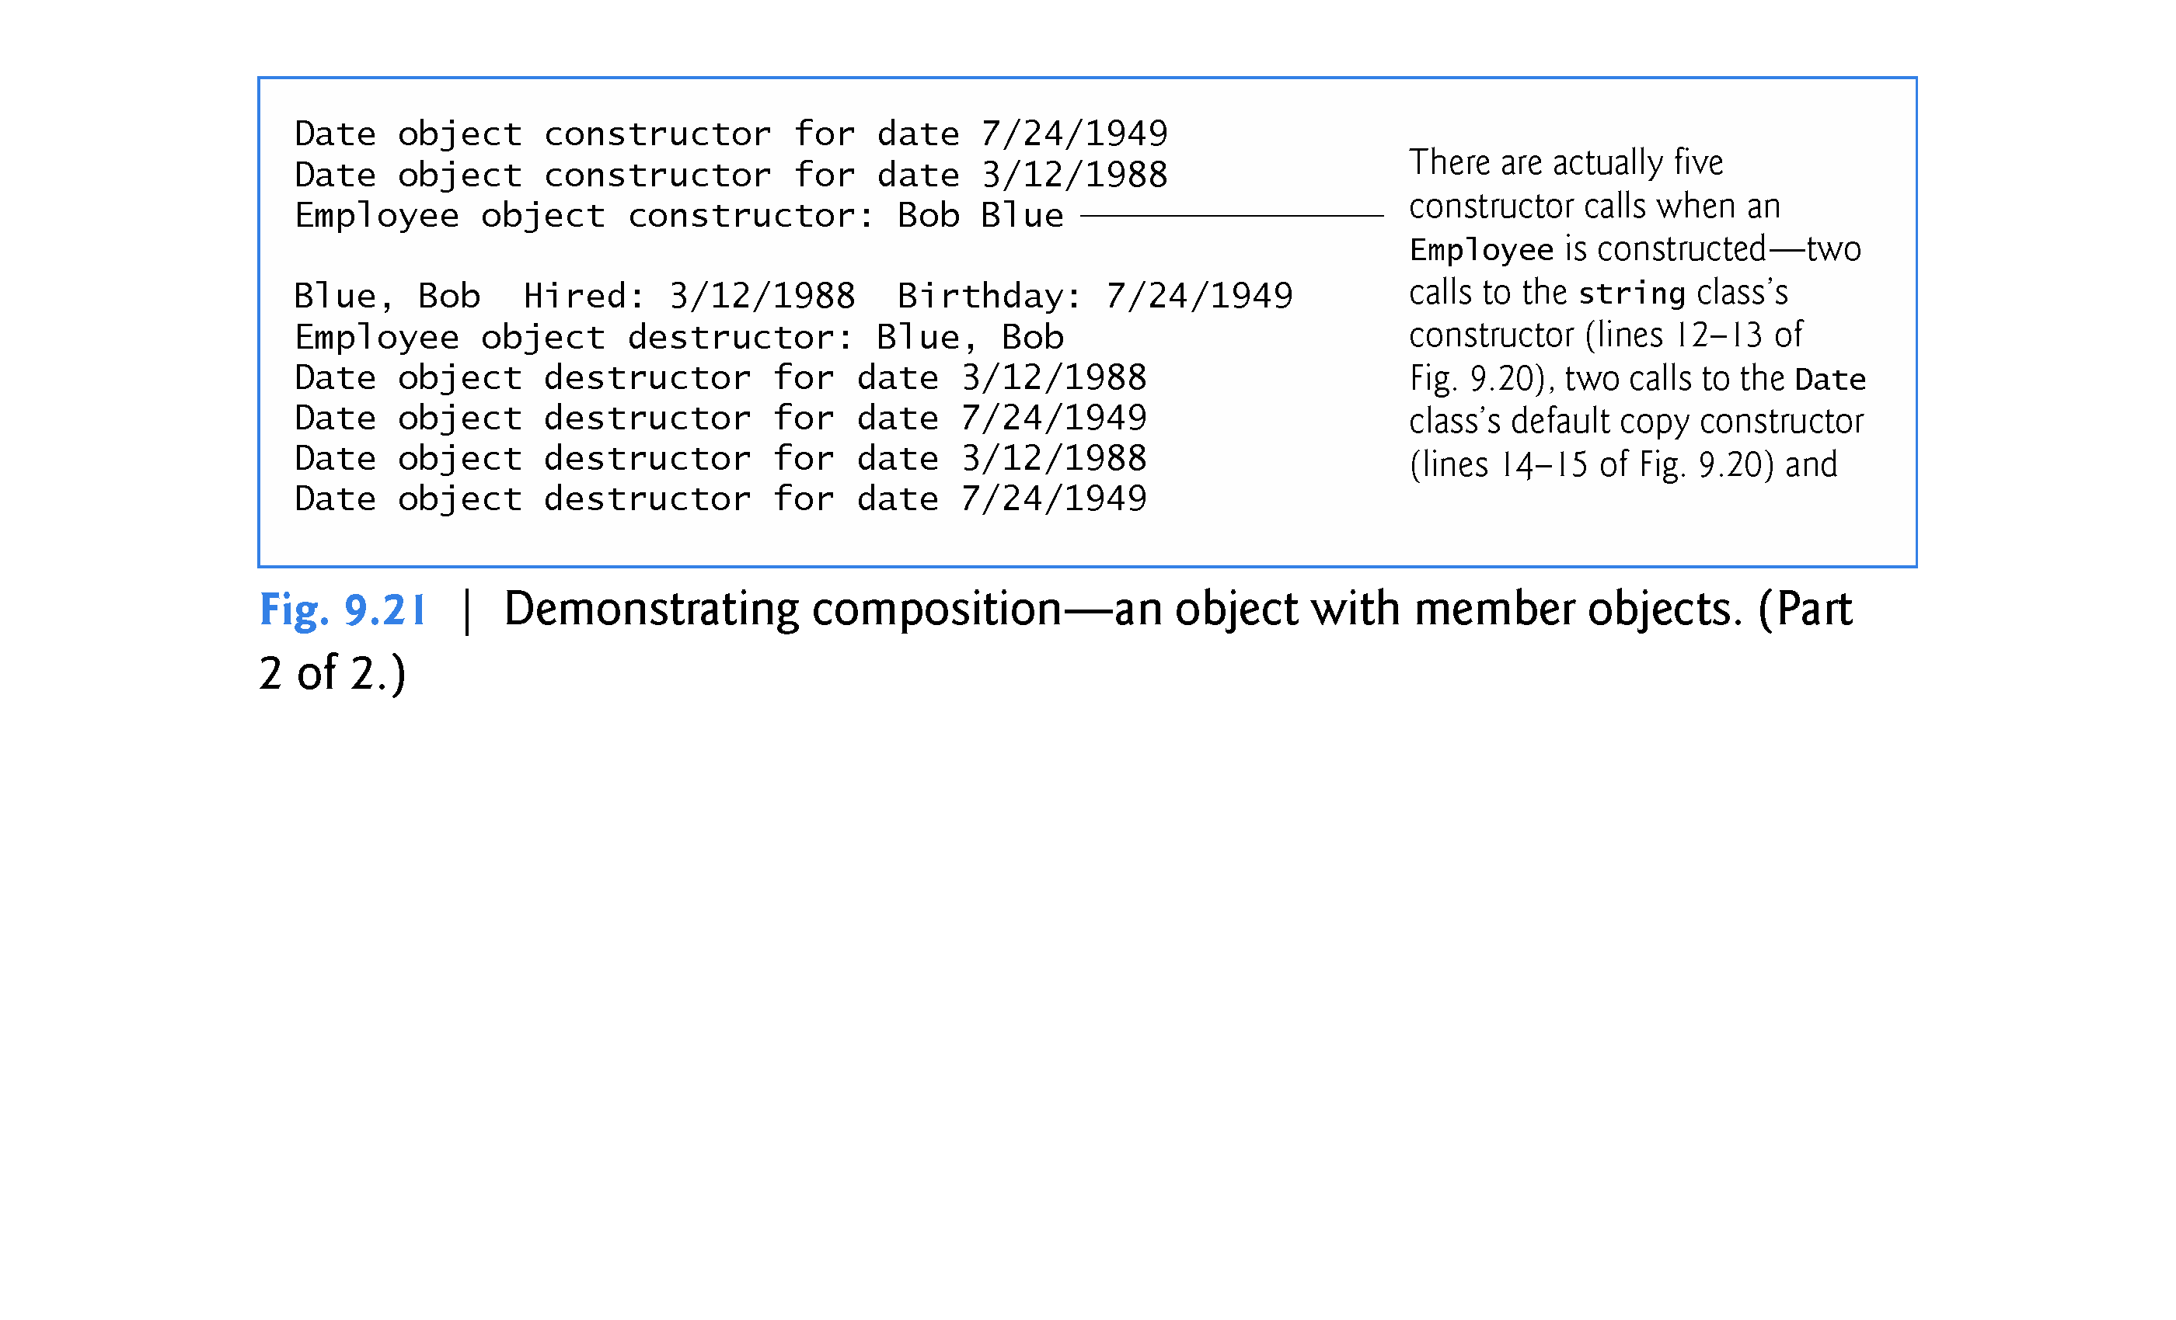

Slide 111
9.11 Composition: Objects as Members of Classes (cont.)
What Happens When You Do Not Use the Member Initializer List?
If a member object is not initialized through a member initializer, the member object’s default constructor will be called implicitly.
Values, if any, established by the default constructor can be overridden by set functions.
However, for complex initialization, this approach may require significant additional work and time.

Slide 115
9.12 friend Functions and friend Classes
A friend function of a class is a non-member function that has the right to access the public and non-public class members.
Standalone functions or
entire classes or
member functions of other classes may be declared to be friends of another class.

Slide 116
9.12 friend Functions and friend Classes (cont.)
Declaring a friend
To declare a function as a friend of a class, precede the function prototype in the class definition with keyword friend.
To declare all member functions of class ClassTwo as friends of class ClassOne, place a declaration of the form
friend class ClassTwo;
in the definition of class ClassOne.
Friendship is granted, not taken—for class B to be a friend of class A, class A must explicitly declare that class B is its friend.
Friendship is not symmetric—if class A is a friend of class B, you cannot infer that class B is a friend of class A.
Friendship is not transitive—if class A is a friend of class B and class B is a friend of class C, you cannot infer that class A is a friend of class C.

Slide 117
9.12 friend Functions and friend Classes (cont.)
Modifying a Class’s private Data with a Friend Function
Figure 9.22 is a mechanical example in which we define friend function setX to set the private data member x of class Count.
We place the friend declaration first in the class definition, even before public member functions are declared.
Function setX is a stand-alone (global) function - it isn’t a member function of class Count.
For this reason, when setX is invoked for object counter, line 41 passes counter as an argument to setX rather than using a handle (such as the name of the object) to call the function, as in
counter.setX( 8 ); //error: setX not a member function
If you remove the friend declaration in line 9, you’ll receive error messages indicating that function setX cannot modify class Count’s private data member x.

Slide 118
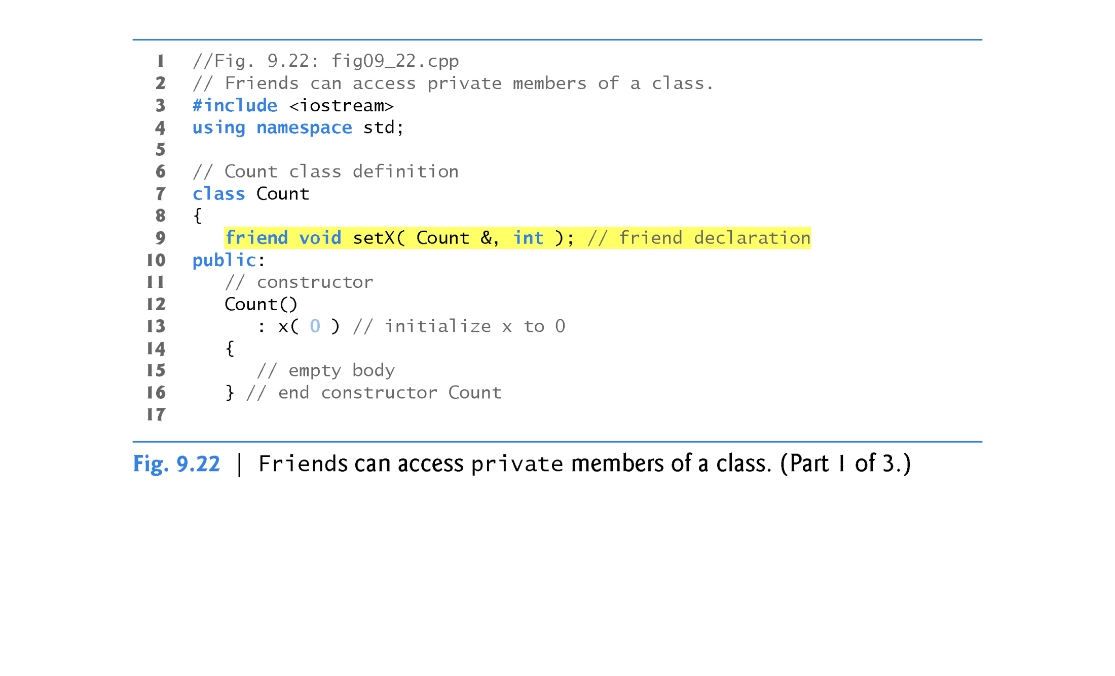

Slide 120
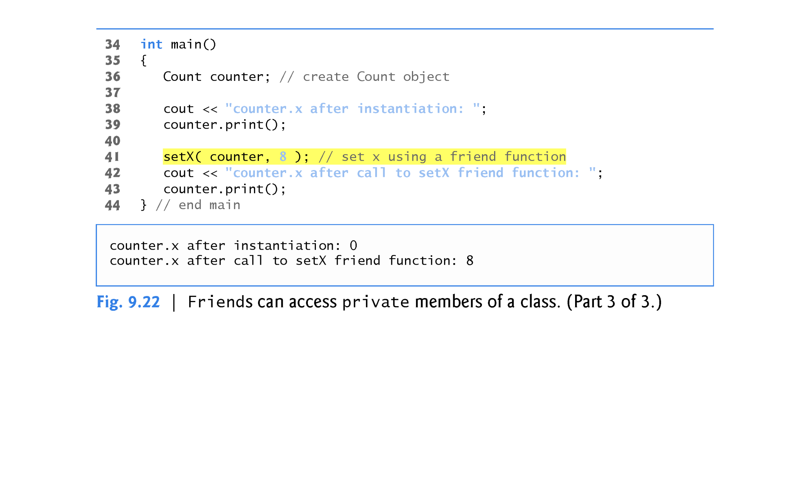

Slide 121
9.12 friend Functions and friend Classes (cont.)
It would normally be appropriate to define function setX as a member function of class Count.
It would also normally be appropriate to separate the program of Fig. 9.22 into three files:
A header (e.g., Count.h) containing the Count class definition, which in turn contains the prototype of friend function setX
An implementation file (e.g., Count.cpp) containing the definitions of class Count’s member functions and the definition of friend function setX
A test program (e.g., fig09_22.cpp) with main.

Slide 122
9.12 friend Functions and friend Classes (cont.)
Overloaded friend Functions
It’s possible to specify overloaded functions as friends of a class.
Each function intended to be a friend must be explicitly declared in the class definition as a friend of the class.

Slide 126
9.13 Using the this Pointer
Every object has access to its own address through a pointer called this (a C++ keyword).
The this pointer is not part of the object itself - i.e., the memory occupied by the this pointer is not reflected in the result of a sizeof operation on the object.
Rather, the this pointer is passed (by the compiler) as an implicit argument to each of the object’s non-static member functions.

Slide 127
9.13 Using the this Pointer (cont.)
Using the this Pointer to Avoid Naming Collisions
Member functions use the this pointer implicitly (as we’ve done so far) or explicitly to reference an object’s data members and other member functions.
A common explicit use of the this pointer is to avoid naming conflicts between a class’s data members and member-function parameters (or other local variables).

Slide 128
9.13 Using the this Pointer (cont.)
Consider the Time class’s hour data member and setHour member function in Figs. 9.4–9.5.
We could have defined setHour as: // set hour value
void Time::setHour( int hour )
{
if ( hour >= 0 && hour < 24 )
this->hour = hour; //use this pointer to access data member
else
throw invalid_argument( "hour must be 0-23" );
} // end function setHour

Slide 130
9.13 Using the this Pointer (cont.)
Type of the this Pointer
The type of the this pointer depends on the type of the object and whether the member function in which this is used is declared const.
For example, in a non-const member function of class Employee, the this pointer has the type Employee *. In a const member function, the this pointer has the type const Employee *.

Slide 131
9.13 Using the this Pointer (cont.)
Implicitly and Explicitly Using the this Pointer to Access an Object’s Data Members
Figure 9.23 demonstrates the implicit and explicit use of the this pointer to enable a member function of class Test to print the private data x of a Test object.
In the next example and in Chapter 10, we show some substantial and subtle examples of using this.

Slide 135
9.13 Using the this Pointer (cont.)
Using the this Pointer to Enable Cascaded Function Calls
Another use of the this pointer is to enable cascaded member-function calls—that is, invoking multiple functions in the same statement (as in line 12 of Fig. 9.26).
The program of Figs. 9.24–9.26 modifies class Time’s set functions setTime, setHour, setMinute and setSecond such that each returns a reference to a Time object to enable cascaded member-function calls.
Notice in Fig. 9.25 that the last statement in the body of each of these member functions returns *this (lines 23, 34, 45 and 56) into a return type of Time &.
The program of Fig. 9.26 creates Time object t (line 9), then uses it in cascaded member-function calls (lines 12 and 24).

Slide 136
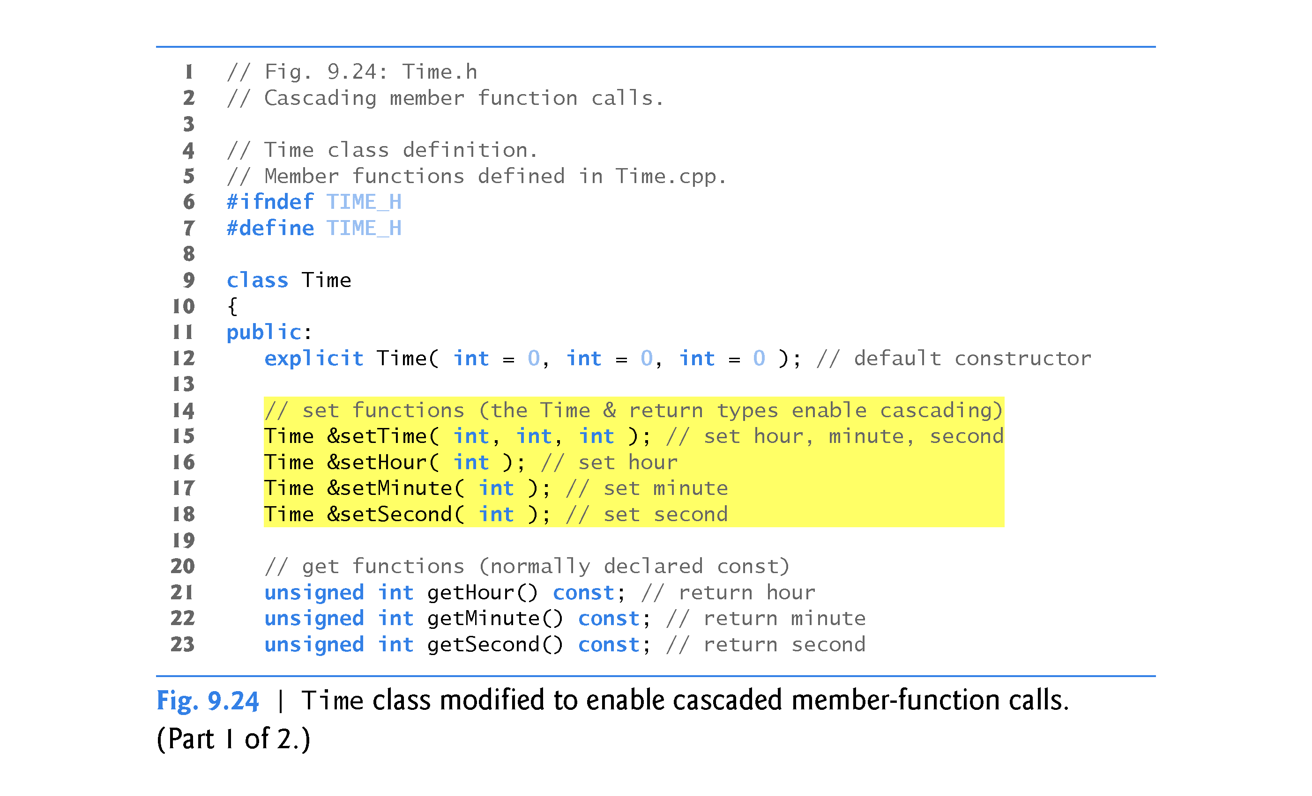

Slide 137
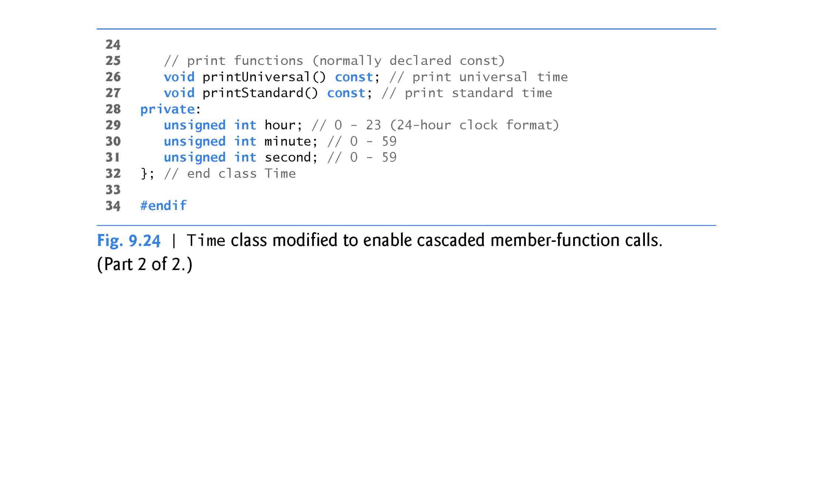

Slide 140
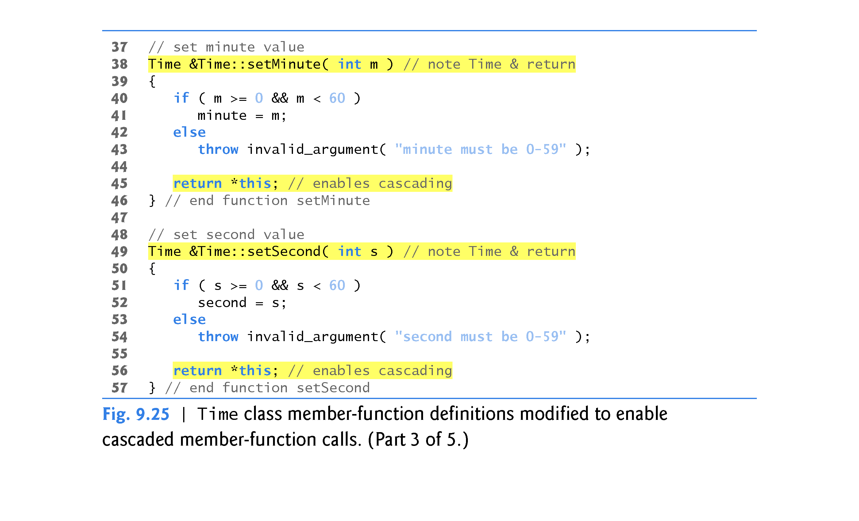

Slide 142
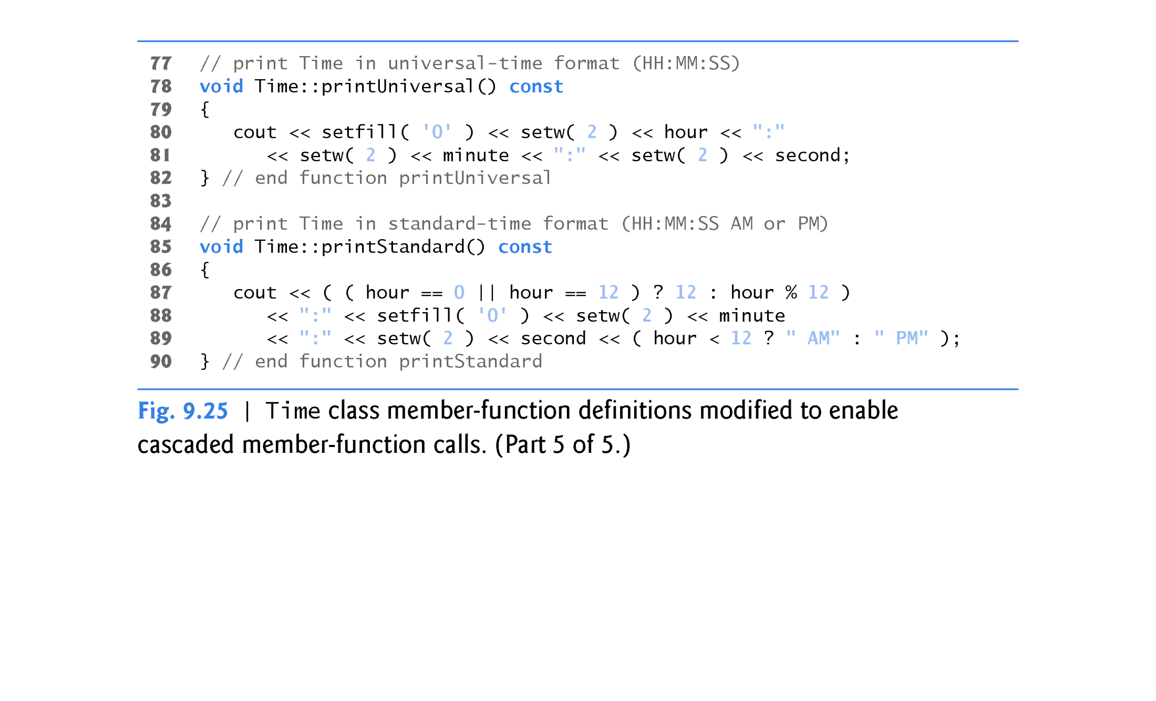

Slide 143
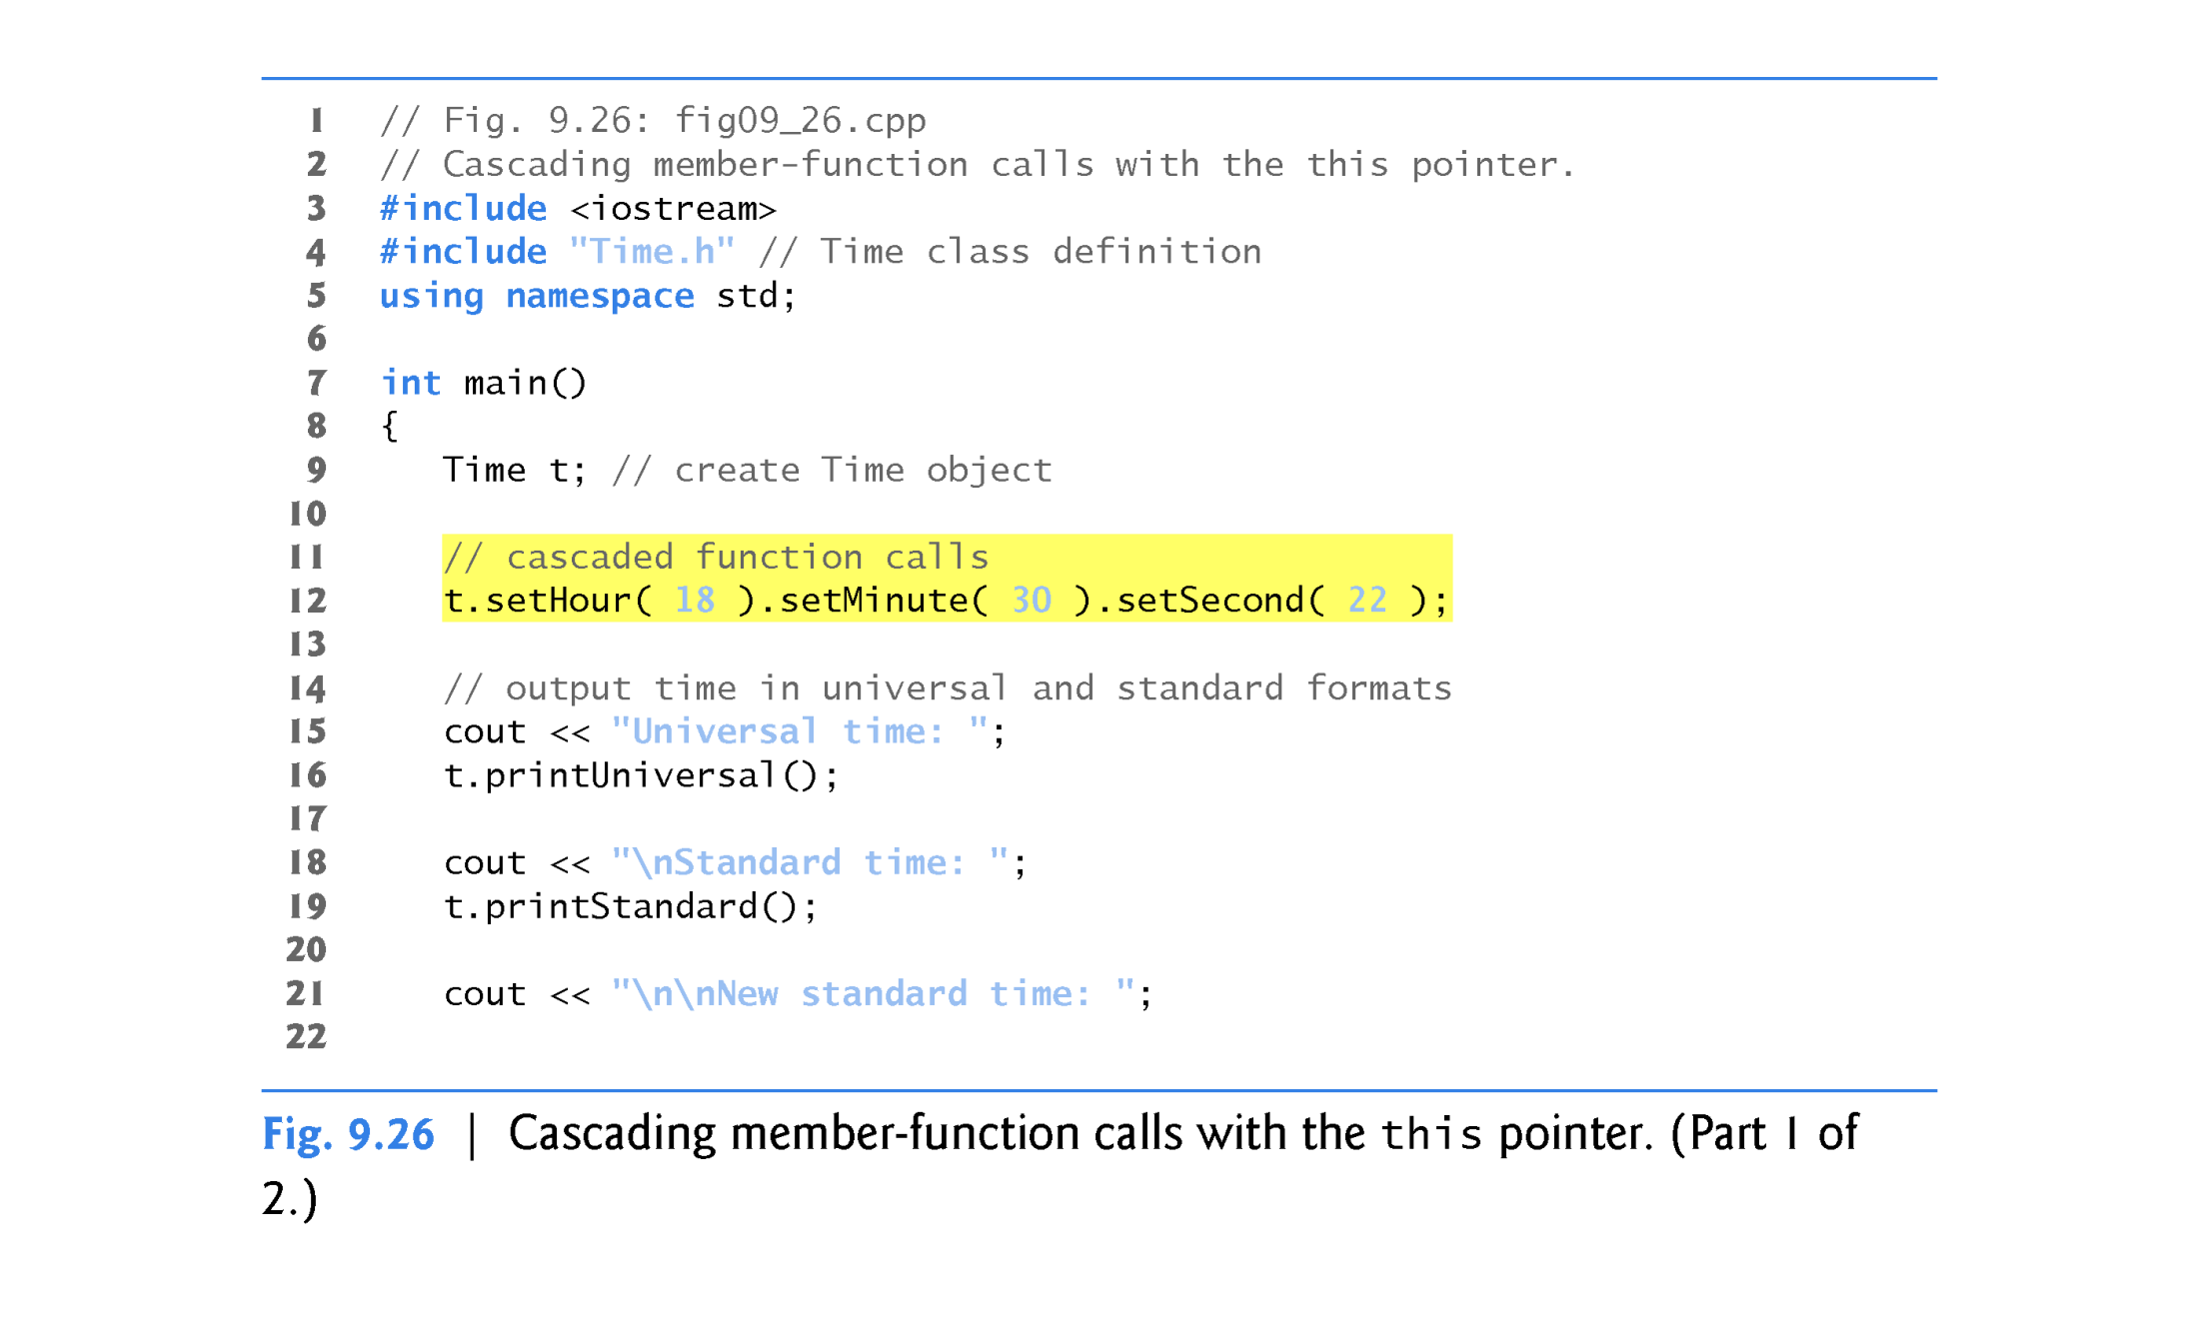

Slide 144
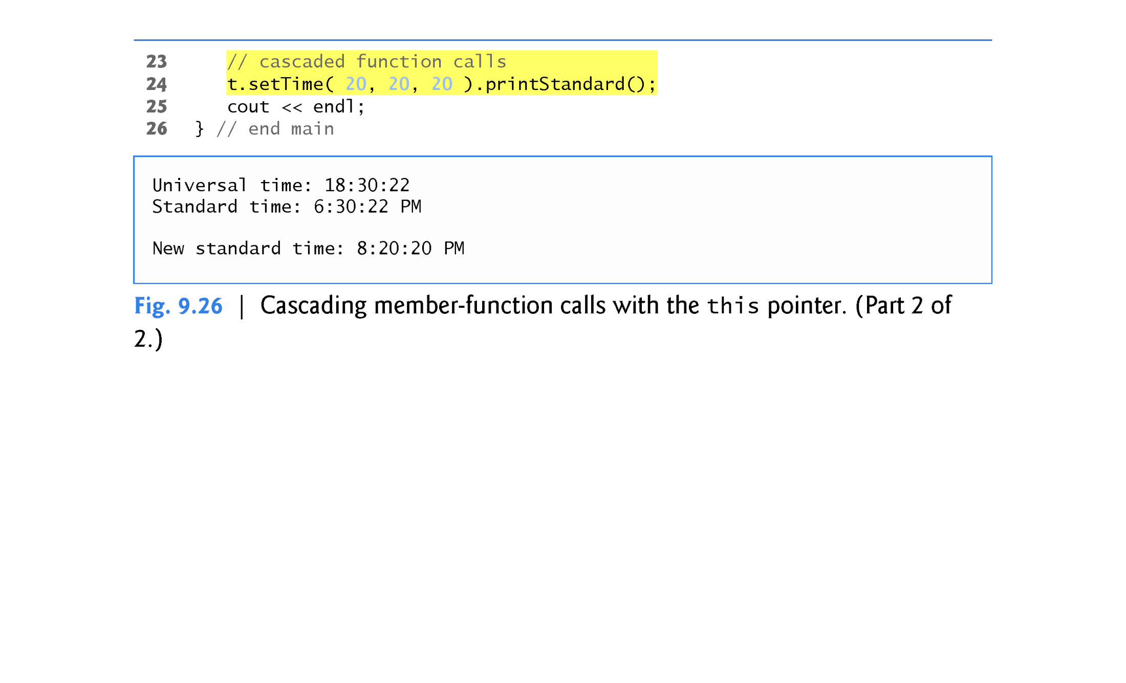

Slide 145
9.14 static Class Members
In certain cases, only one copy of a variable should be shared by all objects of a class.
A static data member is used for these and other reasons.
Such a variable represents “class-wide” information, i.e., data that is shared by all instances and is not specific to any one object of the class.

Slide 146
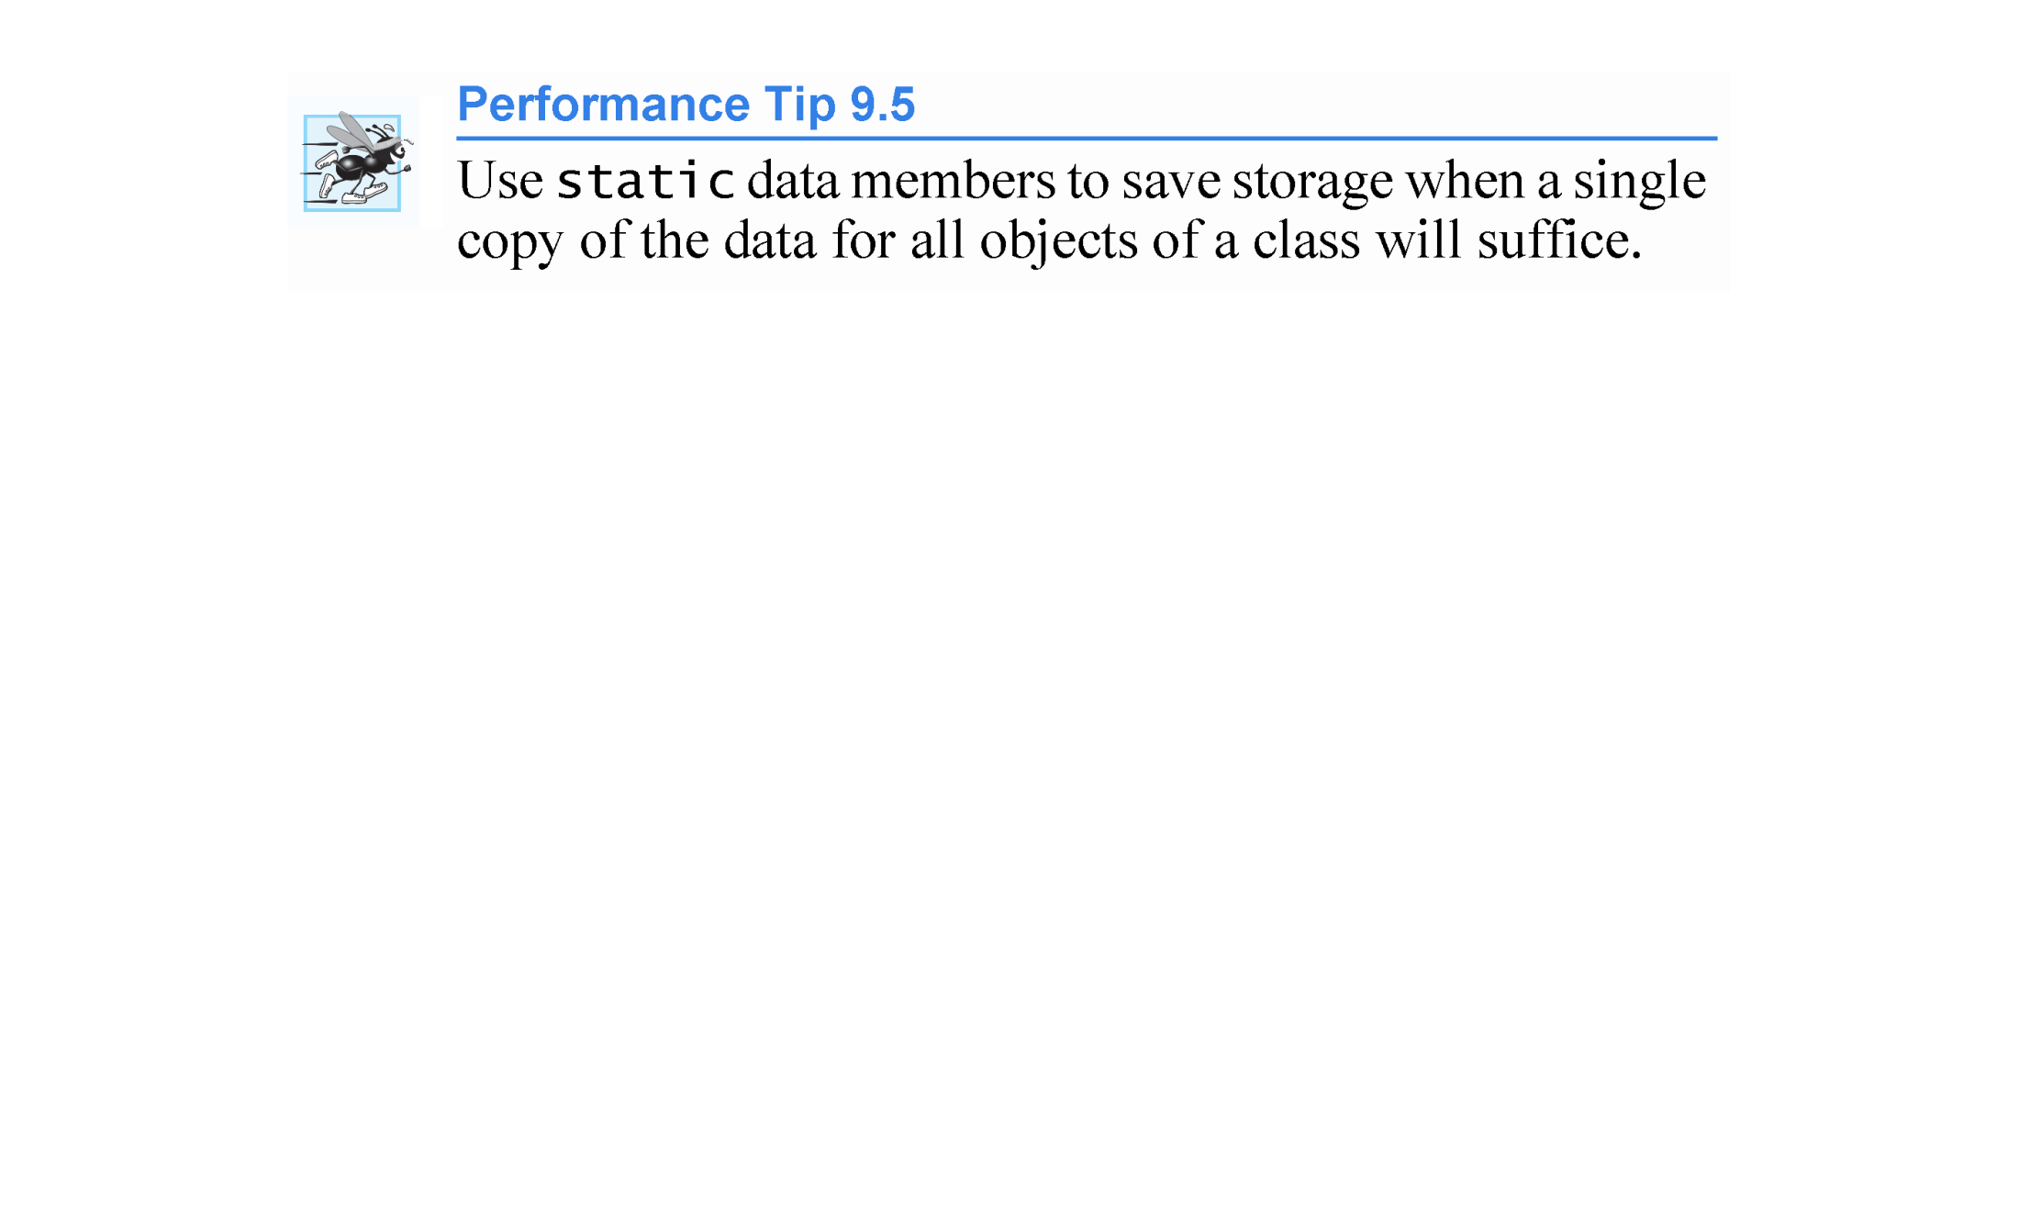

Slide 147
9.14 static Class Members (cont.)
Scope and Initialization of static Data Members
static data members have class scope.
A static data member must be initialized exactly once.
Fundamental-type static data members are initialized by default to 0.
Prior to C++11, a static const data member of int or enum type could be initialized in its declaration in the class definition and all other static data members had to be defined and initialized at global namespace scope (i.e., outside the body of the class definition).
Again, C++11’s in-class initializers also allow you to initialize these variables where they’re declared in the class definition.

Slide 148
9.14 static Class Members (cont.)
Accessing static Data Members
A class’s private and protected static members are normally accessed through the class’s public member functions or friends.
A class’s static members exist even when no objects of that class exist.
To access a public static class member when no objects of the class exist, simply prefix the class name and the scope resolution operator (::) to the name of the data member.
To access a private or protected static class member when no objects of the class exist, provide a public static member function and call the function by prefixing its name with the class name and scope resolution operator.
A static member function is a service of the class, not of a specific object of the class.

Slide 150
9.14 static Class Members (cont.)
Demonstrating static Data Members
The program of Figs. 9.27–9.29 demonstrates a private static data member called count (Fig. 9.27, line 24) and a public static member function called getCount (Fig. 9.27, line 18).

Slide 155
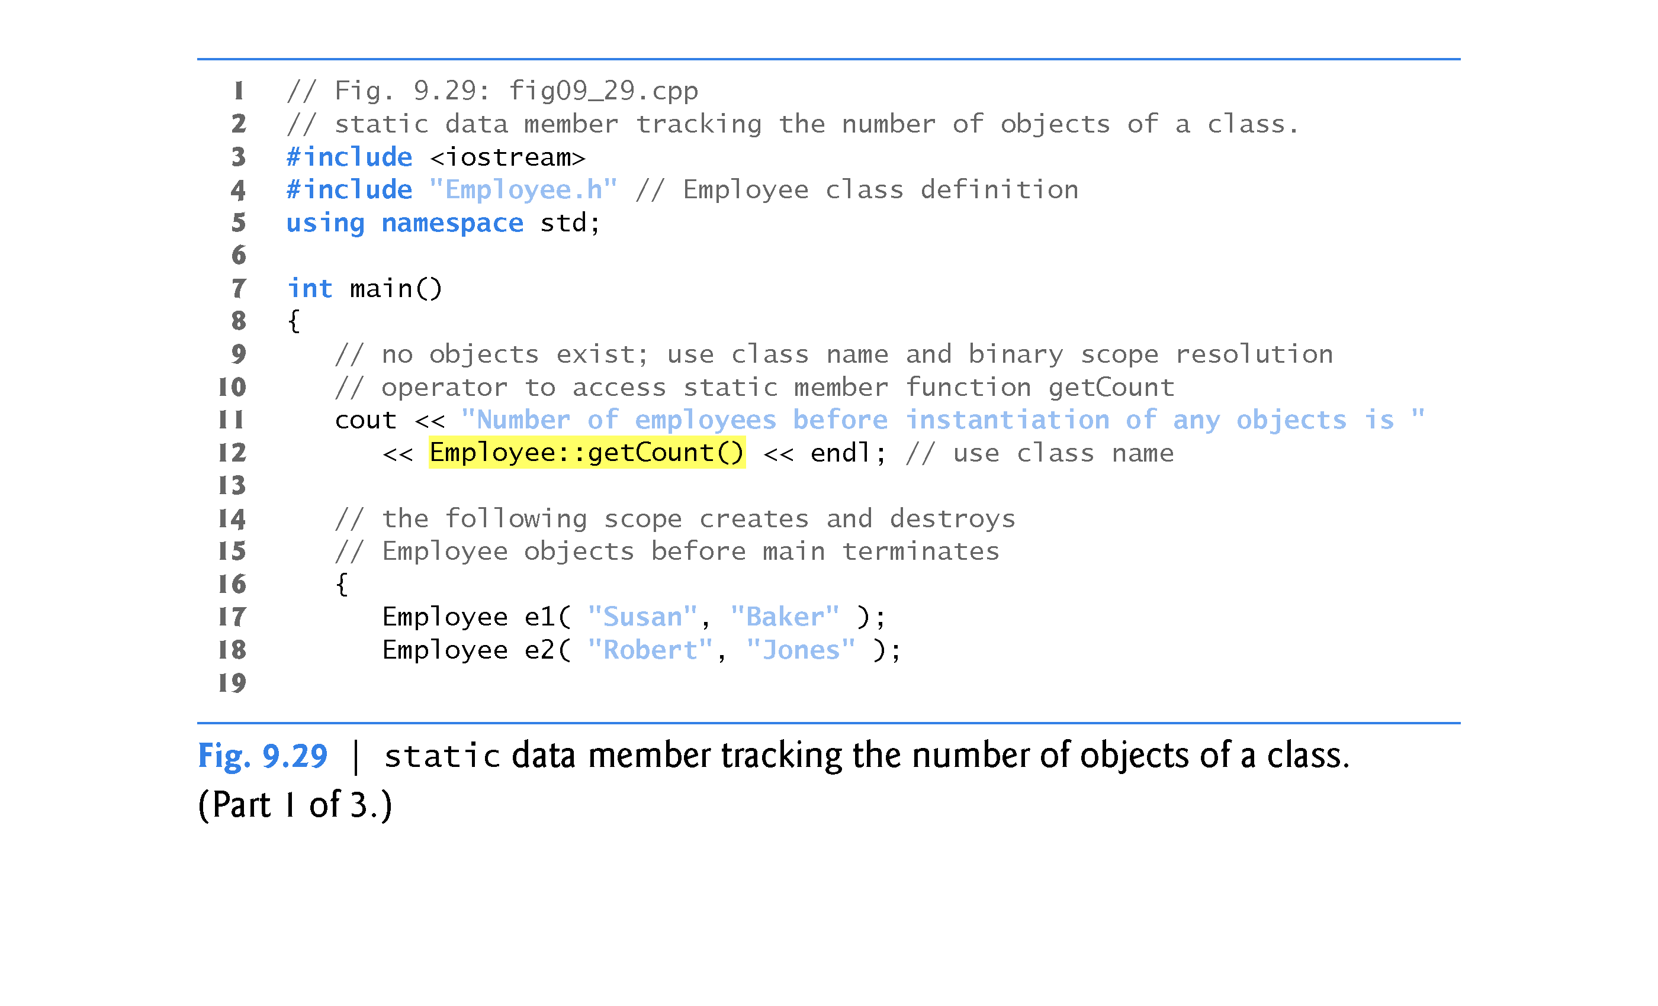

Slide 156
